Slide 1
Coffee with the APDIM Council
Q&A with RC-IM Leadership
January 24, 2022
2:00-3:00 PM EST

Slide 2
Coffee
Q&A with RC-IM Leadership
Identify at least two emotions you are experiencing today.
If you like, share in the chat.
Notes:
Agenda:
Emotional check in.

Slide 3
Coffee
Q&A with RC-IM Leadership
Purpose
Introductions
Format
Discussion

Slide 4
Coffee
Q&A with RC-IM Leadership
Purpose
An open discussion, Q&A with the Council, the APDIM community, and the RC-IM Leadership.
What’s on our minds?
What’s on their minds?

Slide 5
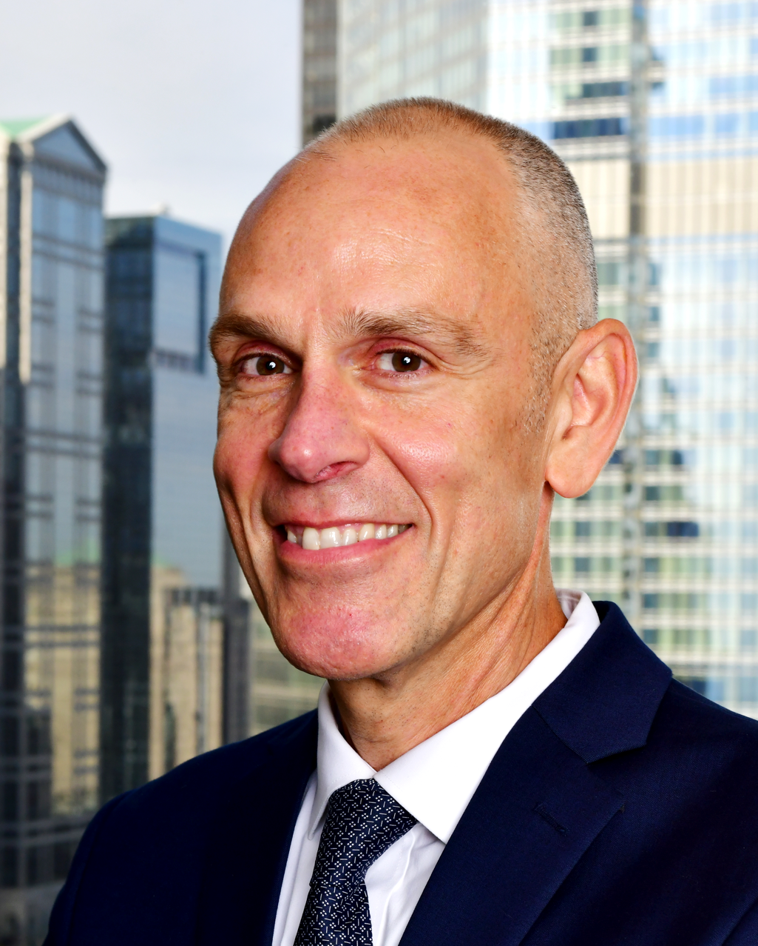
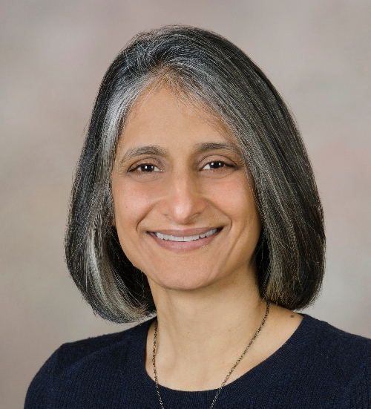
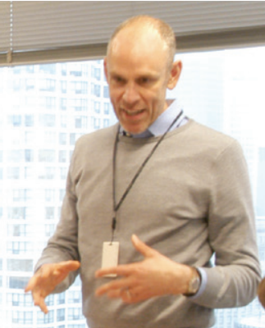
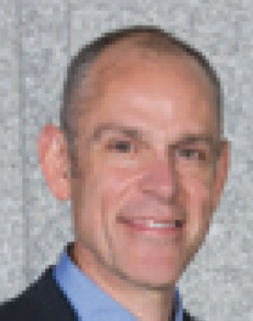
Coffee
Q&A with RC-IM Leadership
RC-IM Executive Director Jerry Vasilias, PhD, and RC-IM Chair Sima Desai, MD
David Wininger, MD, FACP
Jaya Raj, MD, FACP
Erin Maxwell, MPA, MPH, C-TAGME
Susan Lane, MD, FACP
Maria Garcia, MD
Alvin Calderon, MD, PHD, FACP
Kimberly Bates, MD, FACP, FAAP

Slide 6
Coffee
Q&A with RC-IM Leadership
Format
Questions submitted during registration
-Erin Maxwell, MPA, MPH, C-TAGME
Questions submitted in the Chat
-Kimberly Bates, MD, FACP, FAAP

Slide 7
Coffee
Q&A with RC-IM Leadership
Discussion

Slide 8
Coffee
Q&A with RC-IM Leadership

Slide 9
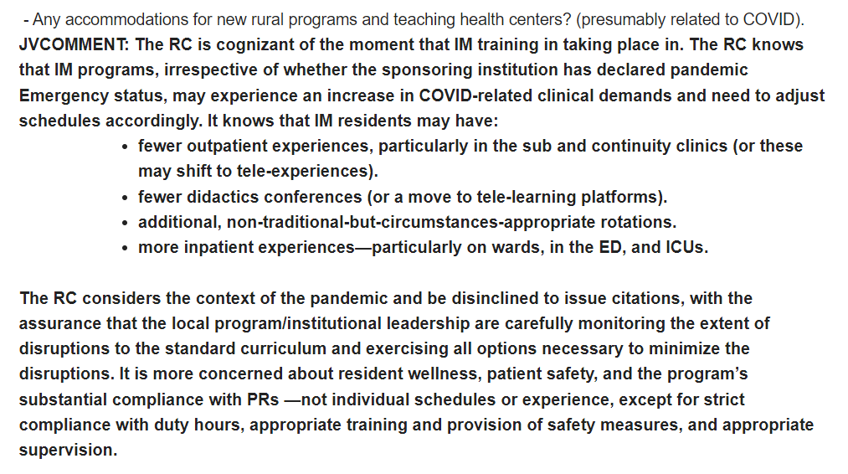
Coffee
Q&A with RC-IM Leadership

Slide 10
Coffee
Q&A with RC-IM Leadership
- Questions about need for protected time (FTE) for program coordinators as well as Core/APD. Other requests to give us more time to implement give budget cycles.
JVCOMMENT: At the September 2021 APDIM meeting and when the FTE requirements were vetted in the fall of 2021, the RC heard from a number of PDs to consider a future enforcement date for the new requirements. It appreciated the comments and asked the ACGME to consider an effective date to July 1, 2022 and an enforcement date of July 1, 2023. The effective date will ensure that everyone knows that there are FTE requirements in place and the enforcement date will give programs and institutions time demonstrate/document compliance with them. The ACGME will be reviewing (and hopefully approving) of the FTE requirements at its upcoming early February meeting.

Slide 11
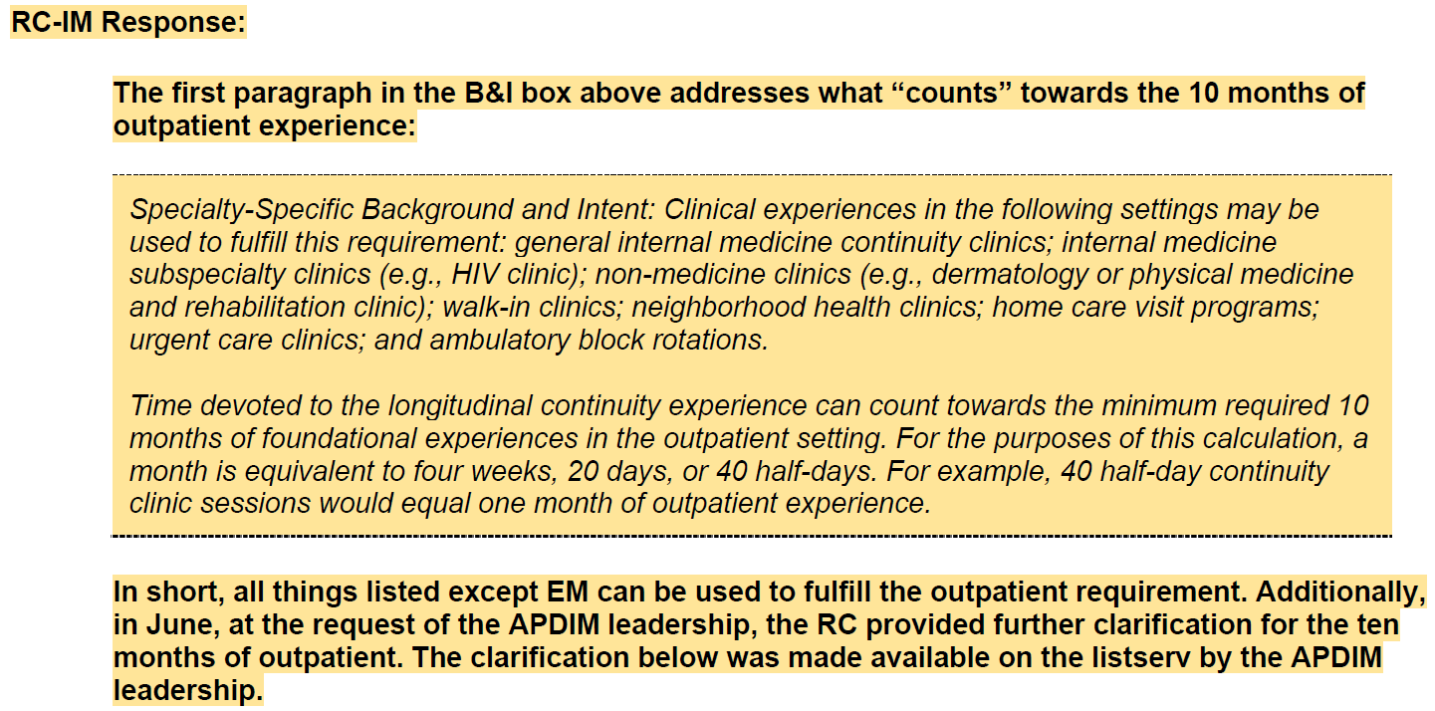
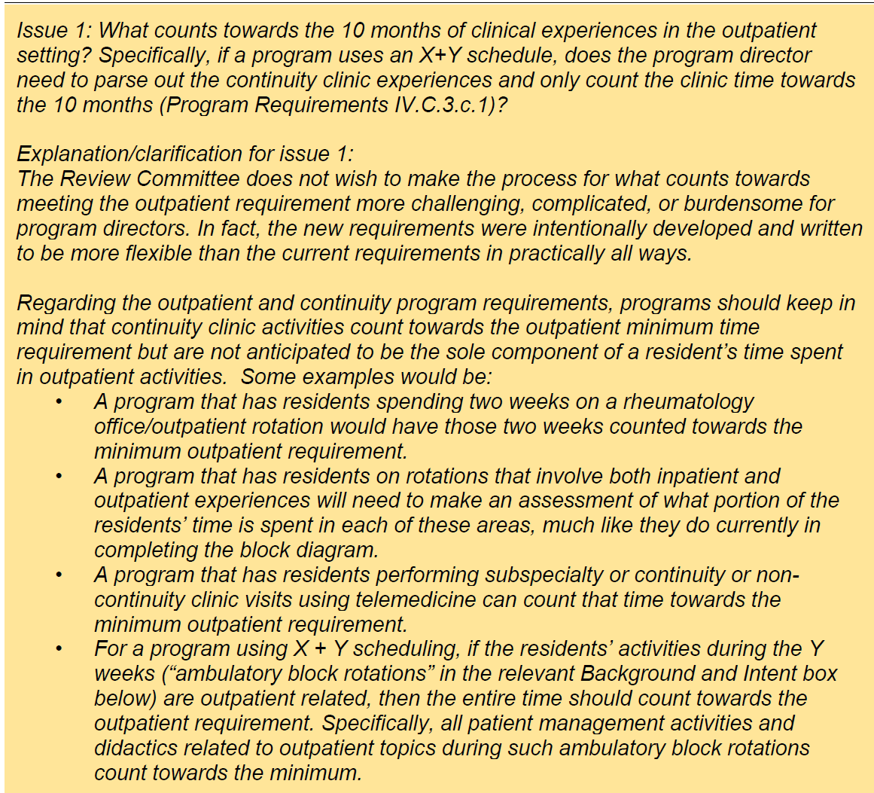
Coffee
Q&A with RC-IM Leadership

Slide 12
Coffee
Q&A with RC-IM Leadership

Slide 13
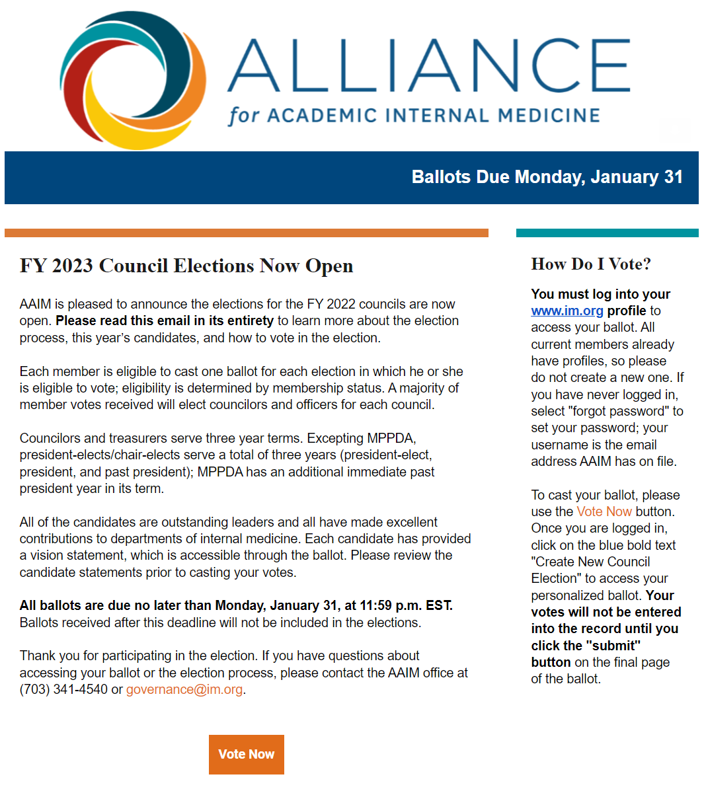
Coffee
Council Elections: VOTE!
Notes:
Agenda:
Emotional check in.
Proposal
Easy mistake avoidance.
July Due date.
Tips for community versus university.
Agenda:
Introduction.
Check in.
Who you are. Community.
Ask why you are here.
Purpose:
How to submit a winning workshop.
Broad overview.
Collaboration.
Ideas.
Tips: Collaborative experience.
Not an innovative topic.
Sharing experiences.
Dominique:
Wide audience.
Different size programs.
Who are you.
Tangible take aways.
What can I use back home
Sharing: Give you rubric
Deliverables.
Steal the idea
Share with others
Encourage people to connect.
Start submitting.
Workshop
Connect at the end.
Question: Why
More you can involve, the better.
Submission:
Mentoring.

Slide 14
Coffee
Q&A with RC-IM Leadership
Thank You!

Slide 15
Coffee
Q&A with RC-IM Leadership
In the chat:
What is one thing you’ll take away from this CWC?
(Optional) Coffee mug selfie!

