Slide 1
Advising Students for the 2021-2022 Internal Medicine Application and Interview Season
Reeni Abraham, MD
Irene Alexandraki, MD
Paul Aronowitz, MD
Diane Levine, MD
Amber Pincavage, MD
August 2021

Slide 2
We do not have all the answers!!
Disclaimer:

Slide 3
ERAS pilot: Logistics
Free, short (15-60 min to complete)
Categorical and Preliminary applicants
Student completes once
Automatically available to all programs they applied to participating in the pilot
Programs can make the supplemental mandatory
Students need to research programs regarding requirements
Participating programs list (352):
https://students-residents.aamc.org/applying-residencies-eras/programs-participating-supplemental-eras-application
Notes:
Amber – 3 min

Slide 4
ERAS pilot: Content
Past experience
Up to 5 most meaningful experiences and why
Program Preference signals
5 unranked programs per applicant (not home institution)
Geographic information
Geographic division
Up to 3 divisions OR
I do not have division preference OR
I do not wish to communicate a division preference
Can free text regarding division or lack of division preference
Urban or rural setting
No preference OR
Slight preference OR
Strong preference
Can free text regarding preference
Notes:
Amber
Programs only see if an applicant signaled their program
Programs only see if an applicant signaled their geographic region, all programs notified if specify “no preference”
Urban or rural setting preference seen by all programs

Slide 5
ERAS pilot: Timeline
List of participating IM programs published 8/10
Students invited September 1st
Students must submit by ERAS application deadline (9/30)
Submitted by 9/19→ available to programs 9/29
Submitted by 9/30→ available to programs 10/6
Students cannot change signal preferences after 9/30
Notes:
Amber

Slide 6
On average, how many IM residency programs did you advise a typical “middle-third-of-the-class” student at your institution to apply to?
2021 CDIM Spring Survey on the
Internal Medicine Virtual Residency Application Process
N = 101
Mode: 30
(9.0)
p<0.001
Mode: 20
(7.3)
Note: Standard deviations reported in parentheses
Notes:
Irene – 2 min

Slide 7
On average, how many interviews did you advise a typical “middle-third-of-the-class” student at your institution to accept?
2021 CDIM Spring Survey
N = 101
Mode: 15
(5.3)
p<0.001
Mode: 10
(3.4)
Note: Standard deviations reported in parentheses

Slide 8
Panel
How would you advise a middle of the road student and a non-competitive student?
Number of applications to submit
ERAS preference signaling
Number of target interviews
Notes:
Amber, Diane, Irene, Reeni, Paul – In order – will stop sharing slides here – goal 10 minutes
Then will open to all in the zoom to comment

Slide 9
Advisor Meeting
Review chart: Student survey, advising form and evaluations
HPI: Student background, specific career plans, values, learning environment
PMH: Personal circumstances, red flags
S
Grades/Step/Rank/Honor Societies
Trajectory/Narrative Evaluations/Clinical Competency
Distinction Tracks/Scholarly Projects/Extracurriculars
O
A
Competitiveness
Red Flags
Interview Skills
P
IM Application Rx (sent to student and Advising Director)
Action items
Notes:
Once an advisor is trained, the first few meetings are completed in conjunction with one of the Advising Committee Co-Chairs (in our case one of the Clerkship Directors). The structure of the meeting is generally the same.
BEFORE the meeting, we ask a student to complete a survey which details their possible letter writers, demographic information, geographic/career interests, and any possible red flags (which are explained). They also complete an advising form with their prior research interests that the advisor can take notes on during their meeting. This advising form is saved to a shared drive after the meeting and is therefore accessible to CDs. Students are asked to reflect upon what type of learning environment do they thrive in. Advisors review these surveys and all evaluations. The meeting is an opportunity to assess the student for competitiveness and interview skills which we will discuss in the next slide in more detail. At the end of the meeting, the advisor and the student discuss a tailored strategy that was coined the ‘prescription’ by my prior partner-in-crime, Blake Barker.

Slide 10
AssessmentAssessment
A
Competitiveness
Red Flags
Interview
Driven by #data
Texas STAR
LOCAL data
Residency Explorer
Scores
Failures
Class Rank
IM Grades
Step
Poor communication skills
Scholarly Pursuits
Research
QI
Med Ed
Global Health
Public Health
Professionalism / Legal Issues
Red Flags
Non-cognitive
Narrative evaluation review
Tracks
Unique Strengths/Interests
Notes:
Reeni- When assessing students competitiveness, I use three categories to guide me. Utilizing the data (which we will talk more about later), reviewing scholarly interests and the non-cognitive skills and interests which are very important to professional identity formation.
I also look at any red flags such as any need to repeat courses, any lower IM grades/test scores which need to be given more meaningful context. We also look for any prior h/o professionalism or legal incidences that would appear on an application or MSPE.
During the session, we pay attention to eye contact, the ability to readily share their story and discuss any prior circumstances.

Slide 11
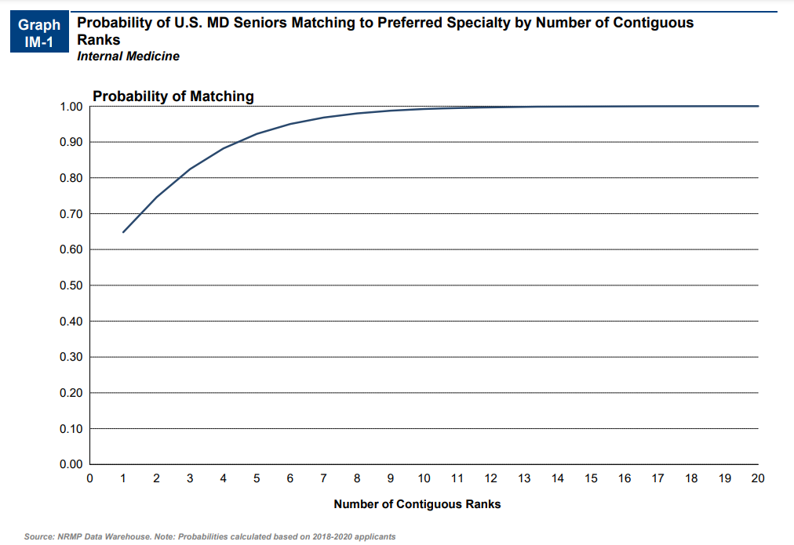
Probability of Matching within IM
Notes:
Reeni- When considering how many interviews students should target, using the AAMC Charting Outcomes in the Match data on the probability of matching based on the number of programs on a student’s rank list is helpful. 99% of students matched when their rank list was 12 programs or below. Approx 90% of students matched if their rank list was 6 or below. This gives me confidence with the students who have competitive scores and who will likely interview well, 8-10 interviews will be sufficient.

Slide 12
Data
01
Texas STAR database
115 schools
Accessible by students and advisors
02
AAMC Residency Explorer
All advising is LOCAL
Prior student match and interview data
Advisor/Dean only
Shared through meetings
03
04
FREIDA/Program Websites
05
Consult an experienced advisor
Locally
CDIM
Notes:
As Marty discussed before, DATA is the key factor to providing sound advice. Being from UT Southwestern, we use the Texas STAR database, as it started in our backyard. It now contains data from 115 schools and is searchable by deans to students, alike and contains A LOT of data on demographics for students who match or interview at certain programs. You can also use AAMC Residency Explorer or FREIDA.
However, the most important tool is the LOCAL data. Just as much of microbiology is LOCAL so goes residency advising. Our school has collated prior match data for at least 5 years as well as for the past two years they have shared weekly surveys during interview season to show where each student gets interview invites and when. This is EXTREMELY helpful when advising a student with similar competitiveness as it allows us to suggest SPECIFIC programs that would interview a student. This data is kept private for advisors and deans only as to not be identifiable.
Students are also encouraged to search program websites.
And for beginning advisors or for challenging scenarios, it is ALWAYS good to reach out to someone more experienced.

Slide 13
Plan
P
Number of Programs → Number of Interviews
Specific Programs → Preference Signaling
Specific Tracks
Schedule Modifications
Personal Statement/CV
ERAS Waiver Form
Timeline, communication
Use the Databases
Program Websites
Reach out to Alumni
Notes:
The culmination of the advising session is a written ‘PRESCRIPTION’ detailing the specifics of number of programs to apply to and suggestion of specific programs based on their interests/needs.
We discuss any modifications or suggestions for their schedule and ask them to send PS/CV/ERAS Waiver form. We reinforce the timeline and the need for continued communication.
We also ask them to TARGET their program list by searching the databases and program websites. We also connect them to alumni with similar prior interests

Slide 14
Relinquishing Interviews
Encourage relinquishing interviews once they have secured enough to predict success
As described in the previous slide, students who have 10 interviews will match
Students may end up interviewing more if a desired program offers a spot later in the season
Encourage relinquishing interviews in a timely fashion to allow the interview vacancy to be filled
No showing to an interview is exceedingly unprofessional and may adversely affect future students who apply to the program
Notes:
We are not sure how the supplemental application will impact interview offers at the programs students are most interested in
We suspect that students will be offered interviews at some (or all) of the programs they signaled.
Once students have secured interviews at desired programs (and safety programs) they should consider relinquishing interviews

Slide 15
Additional Resources
CDIM advising webinar from last year: From Application Strategy through Interview Season: Guiding Students through the Residency Application Process
AAMC Charting Outcomes in the Match Report
ERAS supplemental Participating IM program list: https://students-residents.aamc.org/applying-residencies-eras/programs-participating-supplemental-eras-application
More about ERAS Supplemental: https://students-residents.aamc.org/applying-residencies-eras/supplementalerasapplication
Notes:
Amber

Slide 16
Upcoming CDIM Webinars
Best Practices for the 2021-2022 Internal Medicine Residency Virtual Interview Process: Promoting Equity and Opportunities
Thursday, September 9, from 1:00 p.m. to 2:00 p.m. EDT
Recommendations to Promote Equity in Internal Medicine Clerkship Assessment and Grading Thursday, September 23, from 1:00 p.m.–2:00 p.m. EDT
Notes:
Amber

Slide 17
Thank you!
Notes:
Questions?

