Slide 1
The revised AAIM IM SEL
Reeni Abraham MD, CDIM President-Elect
Susan Lane MD, APDIM President
Notes:
SL - Welcome, can everyone

Slide 2
AGENDA
Debrief
10 minutes
Background
10 minutes
Breakout Rooms
30 minutes
Δs & Call to Action
10 minutes
Notes:
SL

Slide 3
UME to GME Transition
Notes:
SL - The IM Residency Advising Process is a culmination of an investment by our society, our schools and us as educators in the professional development of our students. Transfer the learners we have cared for, invested long hours into the next program that will take them closer to their career goals – that will continue our hard work. UME and GME have one common goal – we want our learners to not only be competent, but to thrive!

Slide 4
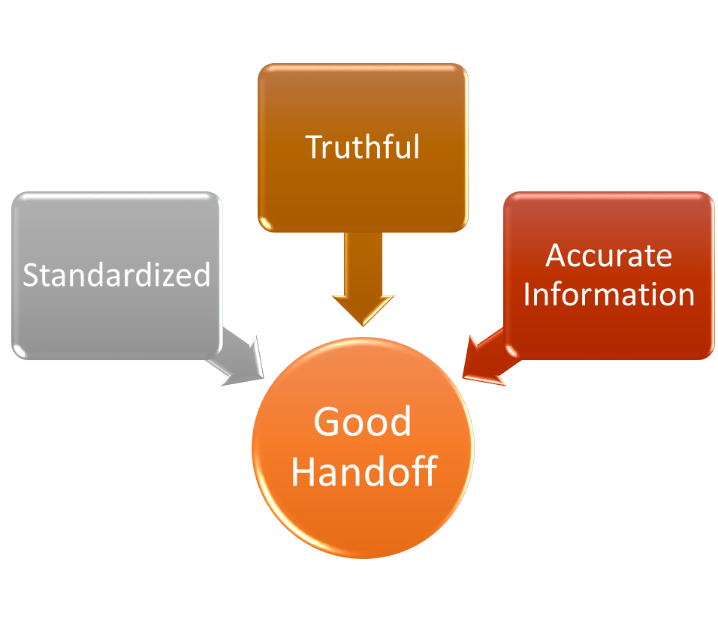
UME to GME Transition
Notes:
RA - When thinking of the UME to GME transition, I think of us as a continuum where the Departmental Letter is a vital handoff tool. We are transferring responsibility of educating these beloved learners to the next program. Good Handoffs build trust between team members and uphold our ethical obligation to be honest and tell the full story in regards to a student’s competency level.

Slide 5
Allopathic Schools
2021 NRMP data:
8,632 total IM positions filled
RANKINGS
3,669
International
Medical
Graduates
GRADES
EPAs
3,416
Osteopathic Schools
1,545
https://mk0nrmp3oyqui6wqfm.kinstacdn.com/wp-content/uploads/2021/05/MRM-Results_and-Data_2021.pdf
Notes:
RA - Residency programs receive applications from three large subgroups: IMGs, DOs and recent US MD graduates. And when you look at the match data IM programs are filled almost equally by allopathic graduates and IMGs with a significant number of osteopathic graduates. The wide variability in systems and lack of standardization feeding into the applicant pool leads to confusion on what our assessment systems should target.

Slide 6
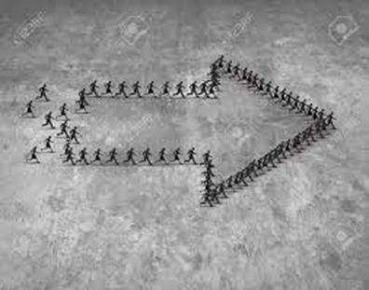
CoPA Recommendations (preliminary)
UME and GME educators, along with representatives of the full educational continuum, should jointly define and implement a common framework and set of outcomes (competencies) to apply to learners across the continuum from UME to GME.
Structured Evaluative Letters (SELs) should replace all* Letters of Recommendation (LORs) as a universal tool in the residency program application process.
*AAIM feedback to CoPA: not all letters should be SELs
https://physicianaccountability.org/wp-content/uploads/2021/04/UGRC-Initial-Summary-Report-and-Preliminary-Recommendations-1.pdf
Notes:
RA - COPA addressed this handoff tool specifically in Recommendations 7, 13
13: A Structured Evaluative Letter, which would include specialty-specific questions, would provide knowledge
from the evaluator on student performance that was directly observed versus a narrative
recommendation. The template should be based on an agreed upon set of core competencies and allow
equitable access to completion for all candidates. The SEL should be based on direct observation and must
focus on content that the evaluator can complete. Faculty resources should be developed to improve the
quality of the standardized evaluation template and decrease bias.

Slide 7
Notes:
RA - THIS SYSTEM DOES NOT EXIST. WE WILL HAVE TO BUILD IT!

Slide 8
How far off the mark are we now?
2013 AAIM DOM Summary letters guidelines with widely variable adherence
Missing descriptions of roles and responsibilities
Missing acting intern experiences
Graphical data more helpful than narrative
Does not apply to allopathic schools or IMGs
No agreed upon terminology
Minimal, if any, useful documentation on non-cognitive clinical skills
Standardized scores not always included, which may delay tailoring resources to applicant’s level
Forces reliance on other standardized metrics
Poor fit/mistrust
Levine D, LaRochelle JS, Kisielewski, M, et al. Current Department of Medicine Summary Letters Are Falling Short. J GEN INTERN MED (2021).
Ferris AH, Pereira AG, Angus SV, et al. Compliance with CDIM-APDIM Guidelines for Department of Medicine Letters: An Opportunity to Improve Communication Across the Continuum. J GEN INTERN MED (2021).
Notes:
RA - Our current process is missing the mark for many reasons. Add references

Slide 9
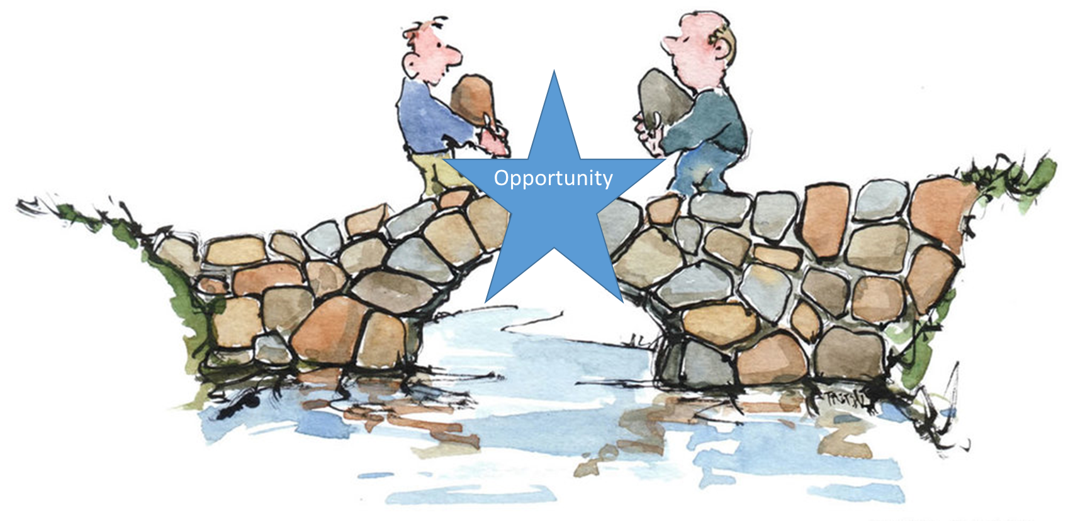
(Eventual) Goals of structured evaluative letter
For schools
Holistic Review
For PDs
Decrease preparation time
Describe highly variable rotation responsibilities
Contextualize performance, if needed
Increase quality of information on non-cognitive and cognitive clinical skills
Decrease time required to interpret
Decrease reliance on standardized test scores
Notes:
SL - Right now there is a gap in our process. Step 1 is now Pass/Fail. CDs have advocated for a more holistic assessment system. We now have an opportunity to be bridge builders and work toward filling this gap. This will take TIME and will surely be an iterative process. Every graduating student has taken our clerkship – we have data on all students. And most IM applicants have had multiple IM experiences, either course work or scholarly. How can we use this time wisely and document these rich observations that are both meaningful to students and future employers?
Various reviews of letters and surveys throughout the years, including the most recent IM In-training exam survey of Program Directors shows the current letters have many missing components to the letter and do not include numerical rankings that are useful to program directors. An APDIM/CDIM workgroup was created that reviewed the most current data and other specialty LOE templates.

Slide 10
2020:
DOM SLOE
Notes:
SL - The COVID Pandemic has wreaked havoc in all of our lives. It also provided a place to reset and review a faulty process to see if it could be made better. It was a time ripe for innovation and collaboration. It was also a whirlwind of a time with decisions needing to be made quickly. Literature showed the EM SLOE had become the most useful document in resident applications which was one of the targets of the UME to GME transition.

Slide 11
Implementation of DOM SLOE – 75 schools reviewed
Notes:
SL

Slide 12
CDs’ feedback for DOM SLOE (v1)
Remove comparative rankings
Bias
Disadvantage allopathic and IMGs
Variable implementation
Meaning
Overhaul of evaluation system
Granular detail
Universal evaluation form
TIME
Highlights non-cognitive clinical skills
Notes:
RA - Students with higher test scores or from more privileged backgrounds have an advantage
Disadvantages allopathic and IMG students
Schools had variable implementation of the IM Qualifications – some contextualized with comments, some used a ranking system
Unclear what the ranking signals to programs. If a school uses lower 1/3 while others do not, do programs equate lower 1/3 to be students who are incompetent in that skill?
The competencies selected may not be captured in your evaluation system; many schools have a universal evaluation form and overhauling these systems will take buy-in from school and above all, time
A lot of feedback praised the inclusion of non-cognitive clinical skills

Slide 13
PDs’ positive feedback for DOM SLOE (v1)
Standardized!
Objective!
Advantageous!
Learning environment specifics!
Student responsibilities!
Notes:
SL -very helpful. Med Schools/CDs should know that letters that do not follow the SLOE format or some other standardized format, and instead provide vague narrative comments without comparative data from the class, put those students at a disadvantage
really liked the standardized format
love the standardized format and objectivity e.g. ranking of thirds for IM qualifications and global assessments
Specific with regard to the learning environment, student responsibilities, patient load etc. (especially important during the pandemic). Allows discernment between top and middle 1/3

Slide 14
PDs’ constructive feedback for DOM SLOE (v1)
Tertiles: used correctly? Right metric?
Very few in lowest 1/3
Some lacked “personal touch”
Not widely used, especially for IMGs
Notes:
SL - putting the students in tertile rankings only works if you actually put a third of students in each of them.
I’m not sure tertiles is what I care about - I want to know if they believe this student will be truly outstanding as a resident, will be an average to above average resident, or will be below average.
Those are not even tertiles, but no medical school has no one in the third one.
Unfortunately, that’s what I think we care about most and this is what schools still won’t tell us - it would be revolutionary if a long-term project between APDIM-CDIM were to come up with some “compassionate off ramps” for the students who just shouldn’t go on to do residency
I don't think many raters actually used the scale correctly (just like all of us with all our inflated scales) as low end scores were certainly not present in 1/3 of letters
Some similarities to MSPE so felt redundant particularly the Core Medicine Clerkship section on graphic representation and narrative. Lacked personal touch eg personal background and interests in IM which Chair LOR valuable. Need more guidance on third rankings (some schools ranked all students in top 1/3)
Not widely used by U.S. medical schools and not used at all by international medical schools; thus it had minimal if any impact on community programs and other programs with large % of IMGs

Slide 15
Notes:
SL

Slide 16
2021:
IM Structured Evaluative Letter
Notes:
SL

Slide 17
IM SEL for 2021
Added evaluation details and types of observers completing evaluations included in the SEL
Qualifications for IM section:
RIME terminology removed
Patient care settings separately defined and listed, focusing not only the floor (competency) but also the ceiling (aspirational)
Comparative language replaced with milestones language (#commonframework) adapted for Teamwork/Accountability, Communication, and Commitment to Personal Growth ratings
Global Assessment eliminated
Notes:
SL

Slide 18
FAQs
SEL TEMPLATE
SEL MOCK-UP
https://www.im.org/resources/ume-gme-program-resources/resources-guidelines-im-sel
Notes:
SL

Slide 19
Template
Primary Evaluator Background
- Not all schools have DOM, Employers for IMGs
Evaluation Details
- Setting/Evaluators
Rotations, Responsibilities, Grade Distributions and Written Comments for Each IM-centric Clerkship and AI
Avoid redundant MSPE comments
OK to repeat grading components for ease of review
IM Qualifications
- Overall comments for context
- Will share in more detail for discussion in breakouts
Notes:
RA

Slide 20
EVERY residency candidate has strengths
EVERY training program has multiple missions
There are different learning environments that can help applicants and programs
Let’s collaborate and build something we are proud of
FLOURISH
Notes:
RA

Slide 21
Notes:
RA - In this process, we will be actively rebuilding TRUST. A movie that is replayed in my house often is the Disney movie, Raya and the Last Dragon. If you haven’t seen it, it’s about a former land called Kumandra where dragons and humans lived harmoniously. Unfortunately an evil enemy caused massive destruction. The dragons sacrificed themselves to create one dragon gem that protects the land. However, instead of coming together during adversity the people separated to form different factions. These factions make assumptions about the other and no longer TRUST one another which leads to a battle that breaks the dragon gem into 5 pieces and allows the evil enemy to return. Raya, the main character, finds the one last dragon, Sisu, who had been in hibernation. Sisu shows that the only way to heal a broken world is to rebuild trust.

Slide 22
“It may feel impossible but sometimes you just have to take the first step, even before you’re ready.” ~ Sisu
Notes:
There have been many times this past year where I have thought about the importance of trust and the terrible fallout of mistrust as I read headlines and talk to my patients and neighbors and I can’t help but hear many of Sisu’s quotes, including the importance of taking the first step no matter how challenging the task.

Slide 23
IMPLEMENTATION
Iterative Process
Breakout Rooms
Identify Challenges
Brainstorm Solutions
Return to meeting room at 3:20PM to share discussion
Focus on IM Qualifications
Notes:
RA – Implementing the SEL is going to be a huge QI project where the feedback of all of you will be instrumental in getting this right! Sheila is going to help break us all out into rooms where you will have a designated facilitator lead you in a brainstorming session where you discuss the major challenges to implementing the SEL over time and think about solutions that could help make this a reality.

Slide 24
Notes:
RA/SL – Before we breakout are there any Questions? Push to breakout rooms

Slide 25
Notes:
Will pull up the whiteboard feature

