Slide 1
Educational (& Efficient) Attending rounds for the 21st Century
Paul Aronowitz, MD, MACP
Health Sciences Clinical Professor of Medicine
UC Davis School of Medicine

Slide 2
Faculty Disclosures
I have no conflicts of interest to report

Slide 3
What we all want to hear at the end of a rotation as a wards attending:
You taught us a lot
You gave us enough autonomy
You gave us enough backup when we weren’t sure what to do
We had FUN
And bonus feedback….
You were a good role model
You were great with patients
You inspired us to be better doctors and learners
We took good care of our patients during our time with you

Slide 4
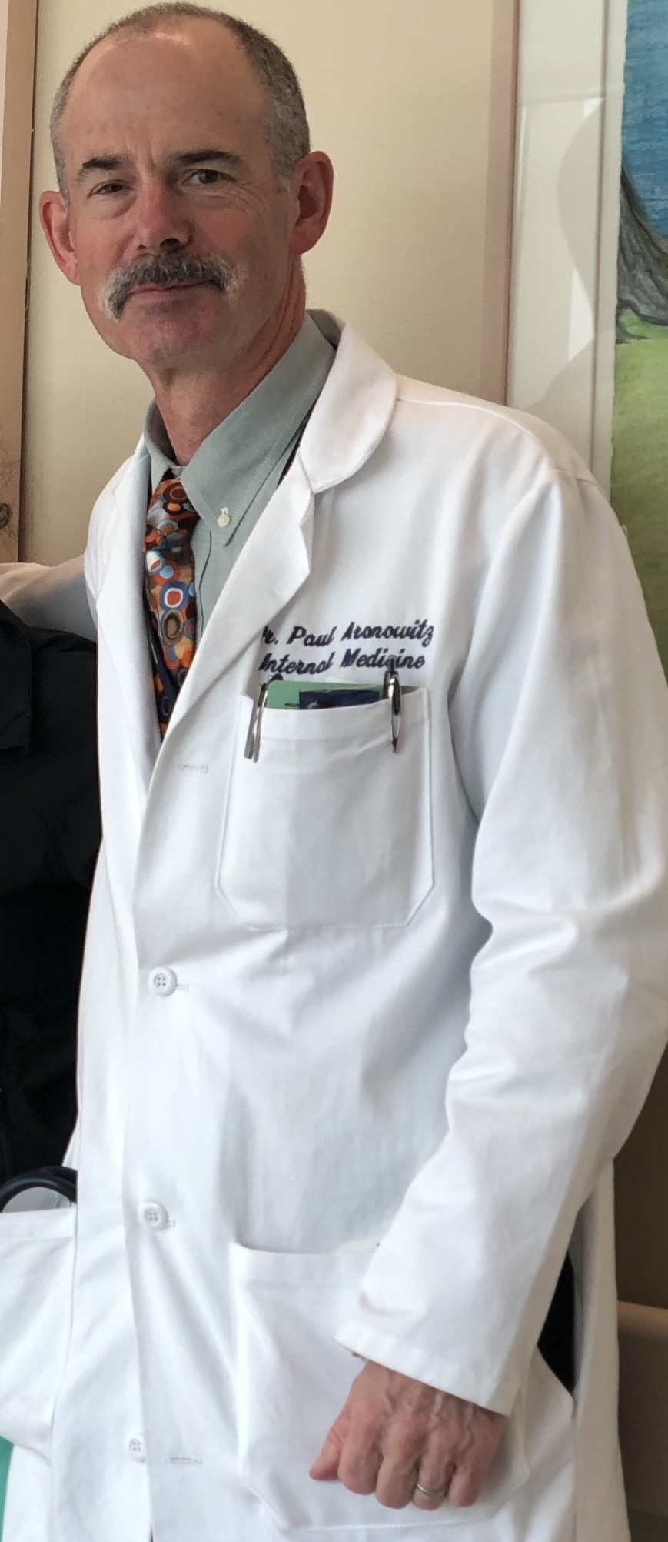
Attending Rounds and Work
Housestaff
Patient Care
(Work)
Education
Notes:
So at the outset here, I’m going to introduce what I think is the basic struggle or challenge that goes on during attending rounds at many institutions across the country. It was the struggle I dealt with when I was an intern and resident exactly 30 years ago and I believe it is at the crux of what most of us as attendings trying to supervise patient care and teach students and residents continue to try and strike some balance with. And it is this—that the residents are the work horses, conscientiously trying to care for their patients and we, while trying to be mentors, guides, role models and supervisors can sometimes get in the way of that work. And I think that the work—and there is a lot of it—is our albatross to contend with. So this Grand Rounds is about how we got here, to all this work in this learning environment, followed by some tips that I hope you can pick and choose from to make your attending rounds more educational and more efficient.

Slide 5
The literature
Opinions/Advice abound
Research mostly qualitative
Very little (substantive) outcomes data on this topic
Pretty amazing, right?
Notes:
Opinions abound, mostly lamenting medicine’s drift away from the bedside and the patients in those beds, into conference rooms and hallways. They also lament our apparent failure to adequately teach compassion, emapthy, the physical exam, clinical reasoning and a host of other things that are lost out on in those conference rooms and hallways.
Most of the research is semi-qualitative—none, that I could find anyway, looks at hard educational outcomes—objectively speaking, do our learners learn more if you run attending rounds a certain way? We know that, in general, the literature says residents tend not to enjoy bedside presentations and being at the bedside as much as patients like us to be there, but we know little about hard educational outcomes about bedside rounds vs. hallway vs. conference room rounds. And do patients get better care if you run attending rounds a certain way. We’re left scurrying about picking up scraps of suggestions from experienced educators—some giants in the field of medical education— who think that they may have effective teaching techniques figured out. So that’s my soapbox about the literature in terms of attending rounds. Still, I have incorporated this literature, as best I could, into the tips during the last half of this presentation.

Slide 6
“Please give me 2-3 tips for educational (& efficient) Attending Rounds”
Jason Napolitano—UCLA (Ronald Reagan Med Center)
James Nixon—U of Minnesota
Joe Rencic—Boston University
Brad Sharpe—UCSF (UC Med Center)
Bob Trowbridge—Maine Medical Center
Donna Williams—Wake Forest
Lisa Winston—UCSF (SFGH)
Vineet Arora—U of Chicago
Todd Barton—U of Pennsylvania
Rabi Geha—UCSF (VA Medical Center)
Jen Kogan—U of Pennsylvania
Jeff Kohlwes—UCSF (VAMC)
Tamsin Levy—Highland Hospital, Oakland, CA

Slide 7
And what did I learn?
A lot of what attendings do depends upon their educational milieu
Take from this talk what is relevant to your “microclimate”

Slide 8
Roadmap
Part 1: How did we get here?
What’s changed since 1889?
Key changes in Graduate Medical Education the last 30 years
Part 2: Attending rounds in the 21st Century—what are we trying to do?
Part 3: Tips for educational (and efficient) attending rounds
Notes:
You all know most of this stuff, but I think that it’s important to contemplate, however briefly, how our wards and clinics and health care systems got to be how they are now, if only because it puts our challenges and how we ended up with these challenges into perspective.

Slide 9
How did we get here?

Slide 10
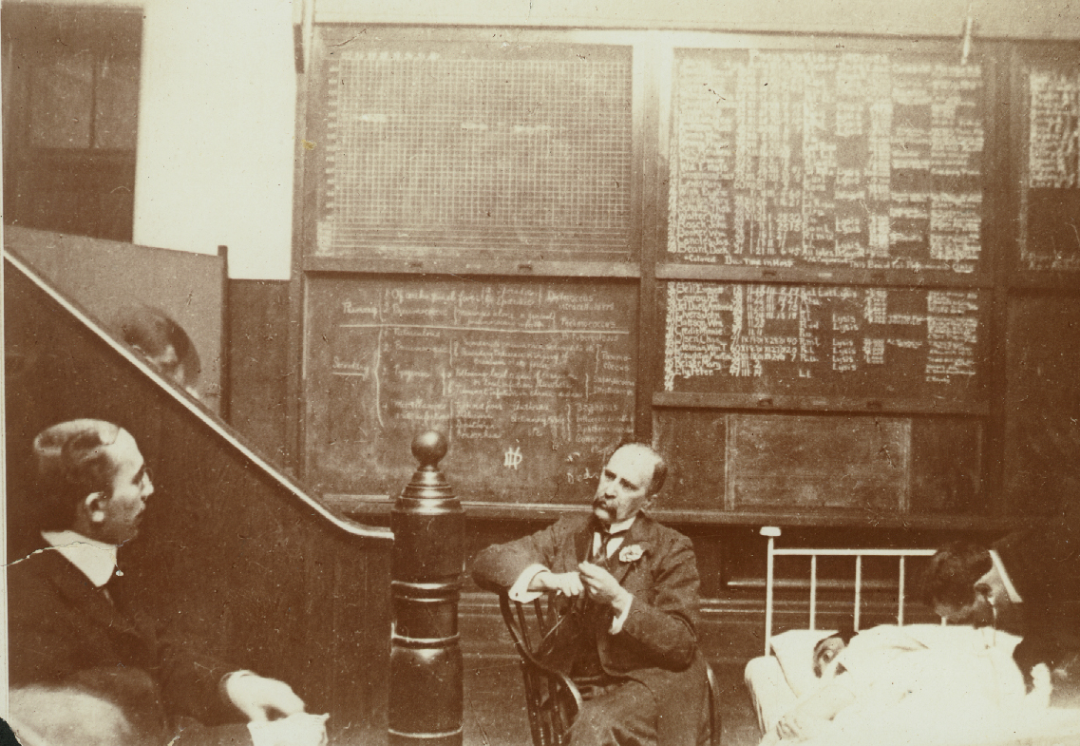
“The days of giants…”

Slide 11
First residency program
Johns Hopkins University 1889
Notes:
Residencies in Medicine, Surgery, GYN

Slide 13
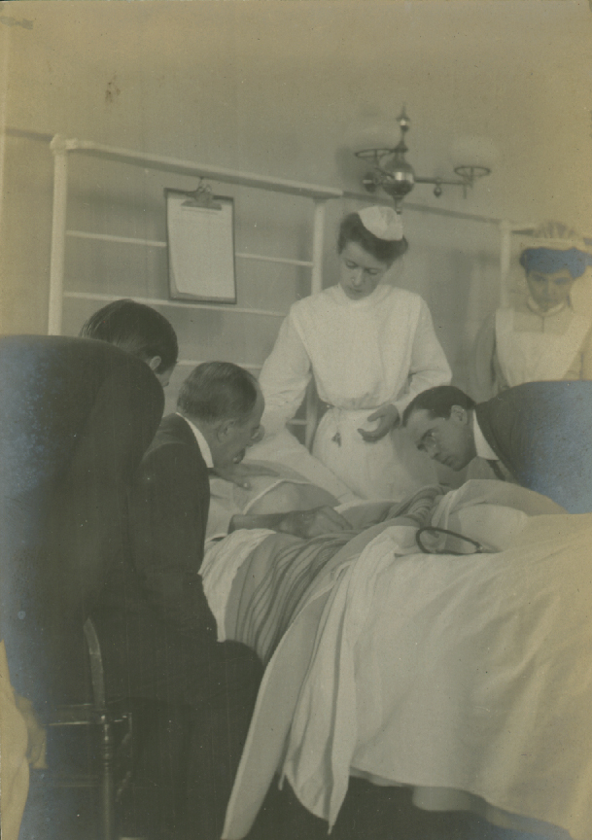
Attending Rounds→ Next 70 years
Patient
Attending
Student
Resident

Slide 14
“Rounds”
Round on patients
Round in the morgue
Round in the lecture hall

Slide 15
Residents
Resided in the hospital
Mostly men
Mostly unmarried
100% dedicated to the science and art of medicine

Slide 16
Patients
Long stays
Very high mortality rate in hospital
Less educated

Slide 17
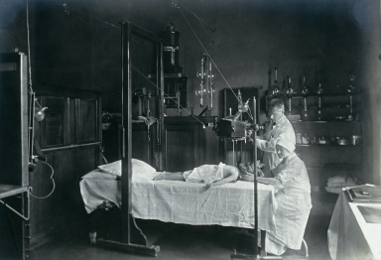
Dx & Rx
Limited diagnostics
No antibiotics
Notes:
See Osler: Story of how Osler died

Slide 18
What were changes to healthcare & education?
….the things we know but don’t really think about much

Slide 19
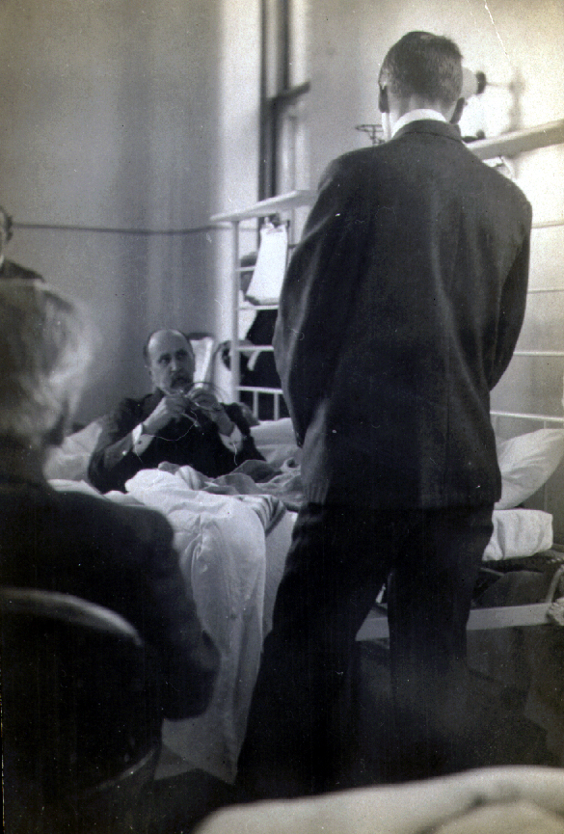
Changes in the healthcare 1950-now
Length of stay plummeted
Technology boomed
Patients got sicker, older &
far more complex
Quality became
focal point
Costs of healthcare sky rocketed
Insurance companies
demand accountability
Medical knowledge exploded
Managed Care grew
Employers
demand Value (Leapfrog)
Etc….etc.

Slide 20
Changes in EDUCATION 1950 through today
Residency Regulations
grew
More married residents than
ever
2003 Work hours
changes
More women than ever before
Life balance and wellness
Increased in importance
2011 Work hours
changes
Hospital focus became
Throughput & Quality
TECHOLOGY
EXPLODED
Residents became lesser
assets than before
Notes:
Exploded from ½ page of regulations in 1980s to 56 pages in the early 2000s

Slide 21
Hospital length of stay (days)

Slide 22
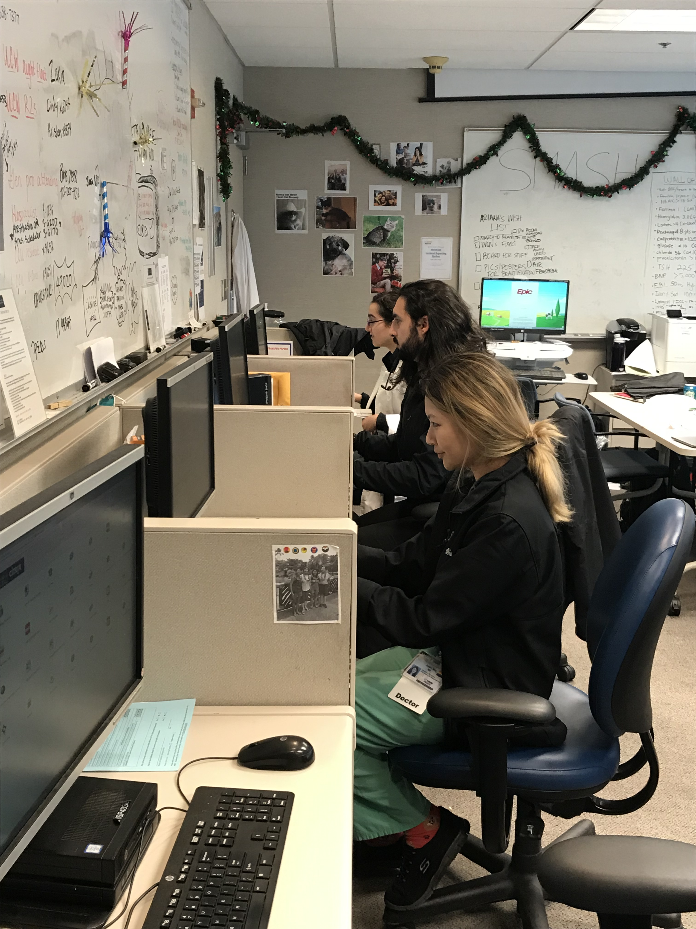

Slide 23
Interns: 40-60% of time on EMR
< 10 minutes/day/patient

Slide 24
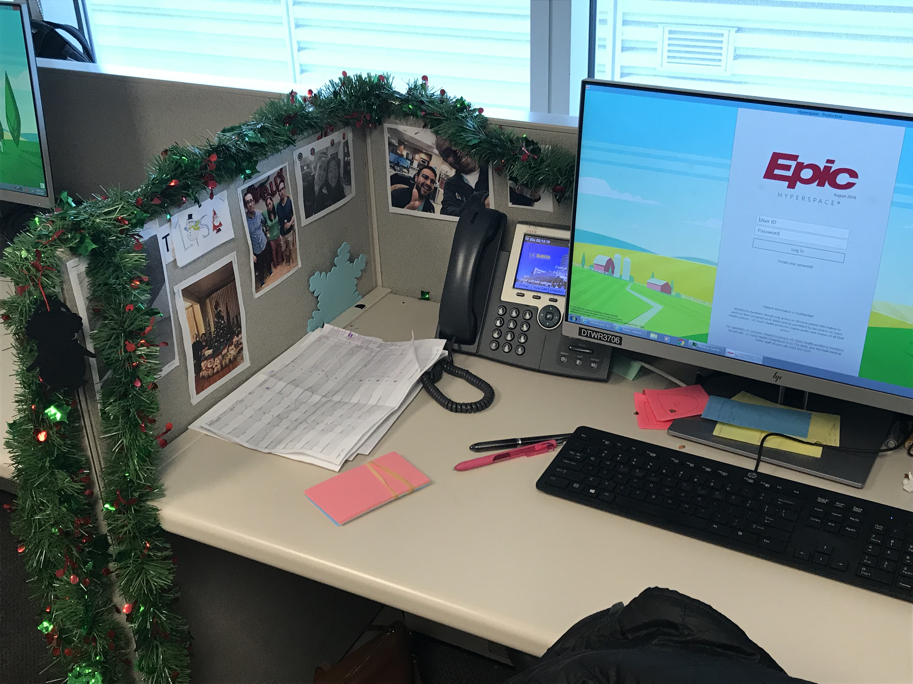

Slide 25
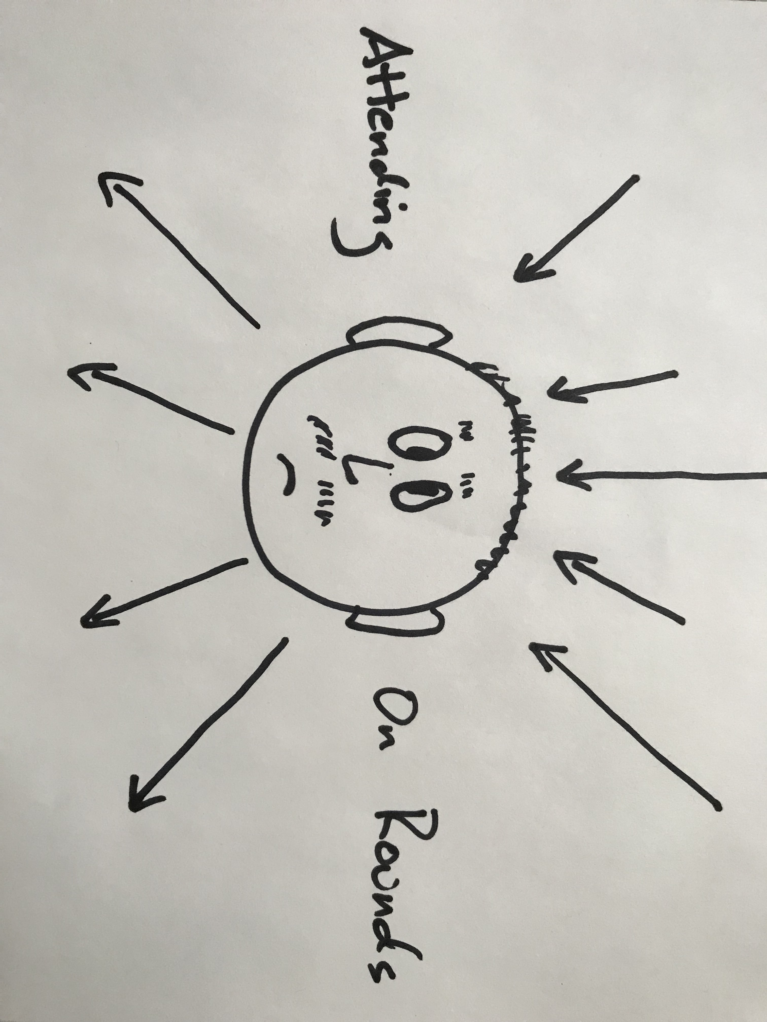
Attending Rounds
Information Overload
Discharge Early
Work Hours Regs
Documentation
Competing with EMR for
attention
Make sure patient care gets done right
Have Fun
And don’t say anything you will regret, or get frustrated, irritable,
or otherwise screw up….
Teach new things
Support learner autonomy
Teaching clinical reasoning
Making sure patients know we care
Teaching physical exam
Inclusion of students
Make sure not inhibiting patient care
Keep everyone’s (anyone’s?) attention

Slide 26
What are we trying to do during attending rounds in 2021?
1- Make sure our patients do well
2- Make sure our trainees are competent
3- Make sure our trainees can practice autonomously by end of residency
-Role Model
-Teach something(s)
-Observe our trainees at the bedside
-Spark curiosity
-Stimulate a spirit of inquiry
-Keep learners happy/healthy

Slide 27
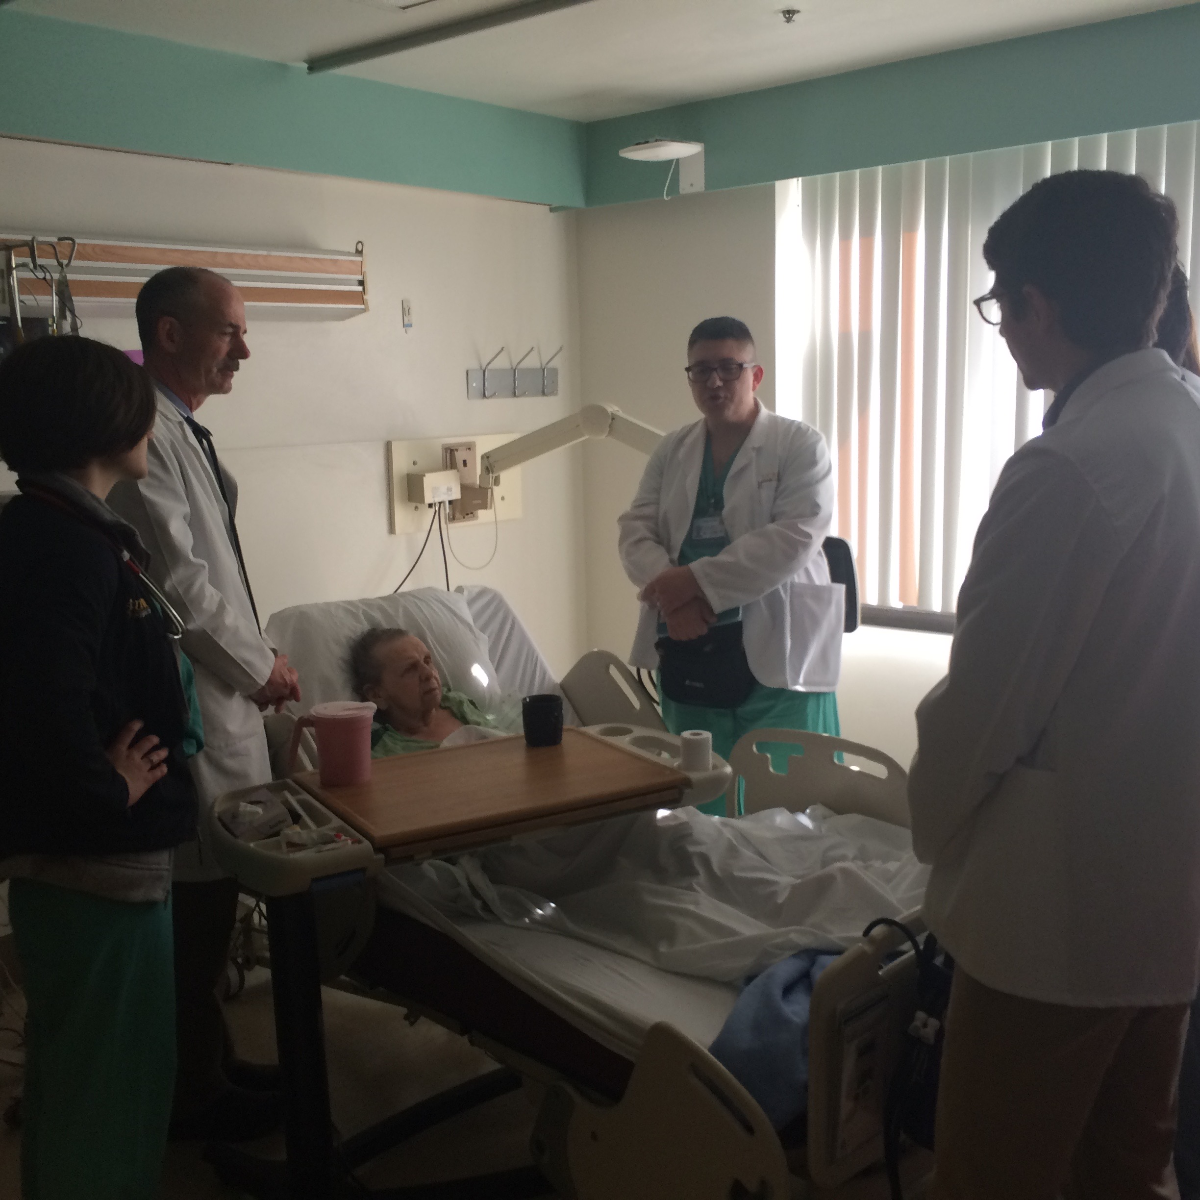
So how do we do all these things?

Slide 28
Part 3: 15 Tips—For Educational and Efficient attending rounds

Slide 29
Tip 1— REFLECT→ Figure out what you want your attending rounds to be--
Take yourself out for a (re)treat
Decide what your priorities are on attending rounds
Adjust this to where your talents are—what are you good at?
What are you passionate about?
Make a “mission statement” or list some goals
Notes:
Because, like snowflakes, no 2 attending rounds are exactly alike—you have to have an apsirational target for what you want. And even then, you may never reach that target but it gives you something to strive for.

Slide 30
My goals
-Take good care of patients
-Embrace “thin ice”
-Teach students & residents to observe better and look more carefully
-Make sure learners learn something and have fun at the bedside
-Know what they don’t know and teach that
Notes:
#4 so that they’ll want to do more of it and will do the same when they become clinician educators

Slide 31
Know what they don’t know and teach that
Notes:
If you don’t know this, you may be the attending name on a chart, but you may be wasting the time of your learners on rounds

Slide 32
Tip 2— After you identify goals and talents
Set goals for what you want to get better at
Study it & practice it

Slide 33
Expert
Performance
Experienced
Time

Slide 34
Examples of goals to get good at…
Auscultation of murmurs
Fingernail findings
Common Rashes
Common odors in disease states
Good criteria to use in medical decision making
Teaching medical history tidbits

Slide 35
Tip 3—Setting Expectations Email 1-page expectations to team members 1-2 days prior to starting
How you want rounds to run
What you expect from each team member
What you like to do on rounds
What you don’t like to do on rounds
Who is in charge of the rounding “road map”

Slide 36
Tip 4— Teach in nibbles and only what is relevant to each patient

Slide 37
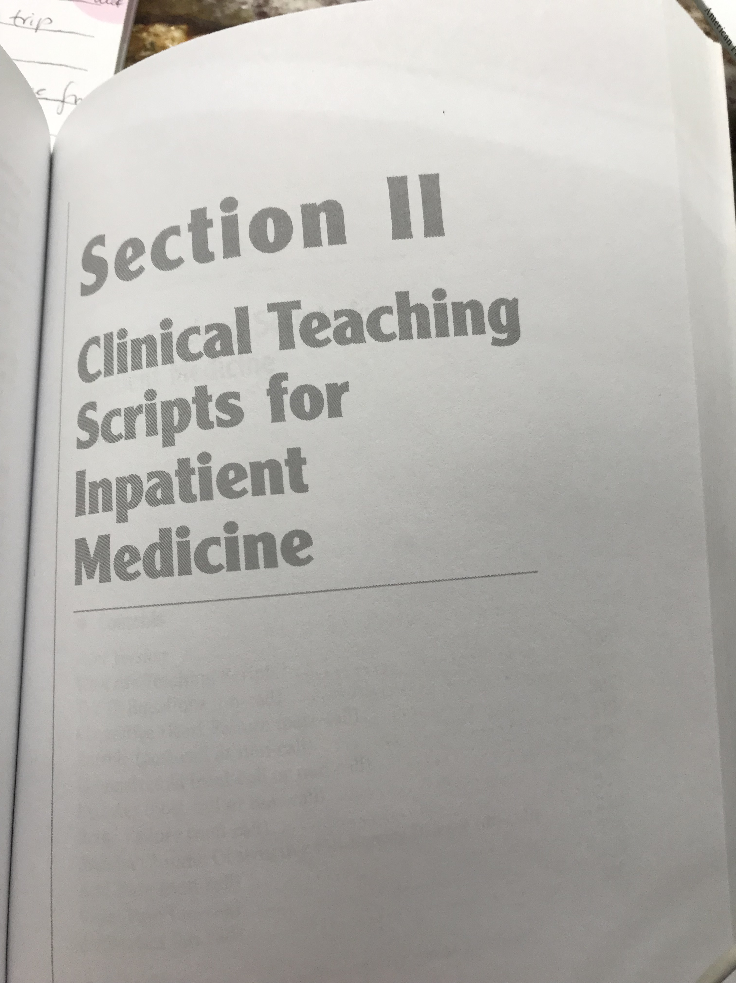
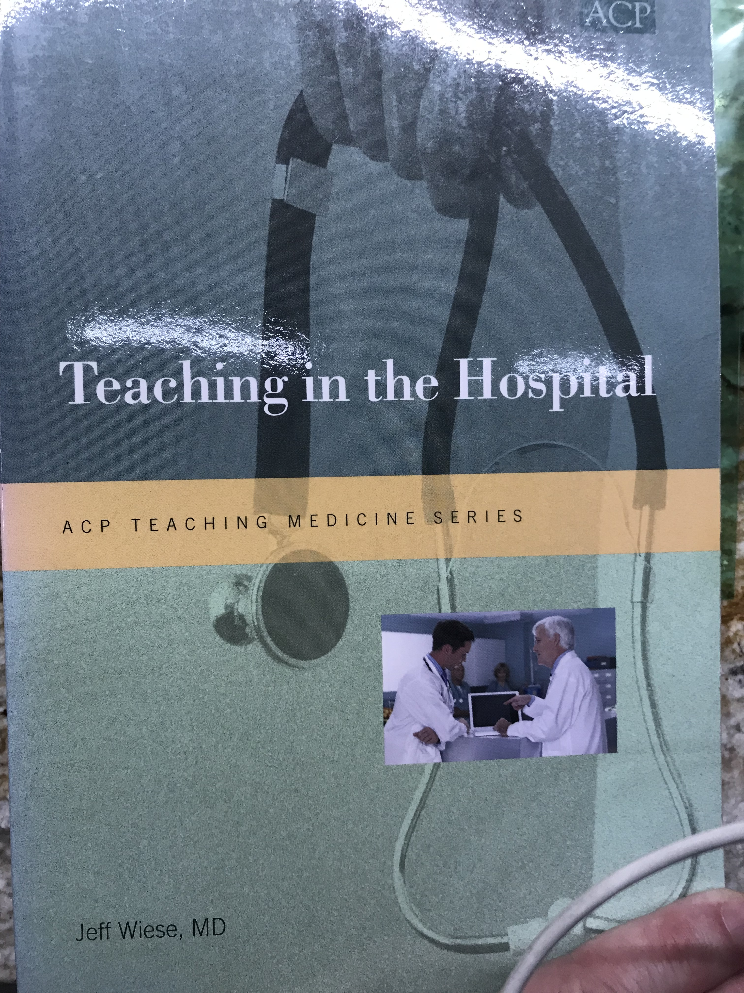
Tip 5— Use “Teaching Scripts”
Notes:
This is something that most of you are already doing—but you might not be calling them teaching scripts. Jeff Weise has a nice section on them in his book in the ACP Teaching Medicine series called teaching in the hospital.

Slide 38
Examples of Teaching Scripts
Your approach to hyponatremia
How to read a chest radiograph
How to differentiate different systolic murmurs in the same patient
How to find the JVP using tangential light
How to read an EKG
Skin findings in Cirrhosis
Well’s Criteria

Slide 39
Teaching Scripts
Build your scripts around what most students & residents don’t know (but encounter a lot)
How long does Furosemide (Lasix) last? Oral? IV?
Notes:
But also build the scripts around things that align with your mission for teaching at attending rounds. Smoker’s face teaches them something about medicine but it also teaches them to look closer and more carefully at their patients.

Slide 40
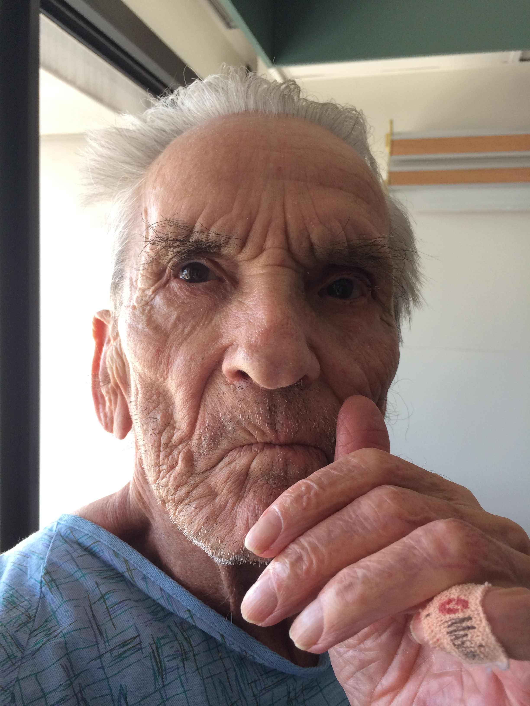

Slide 41
Dx:
Smoker’s Face

Slide 43
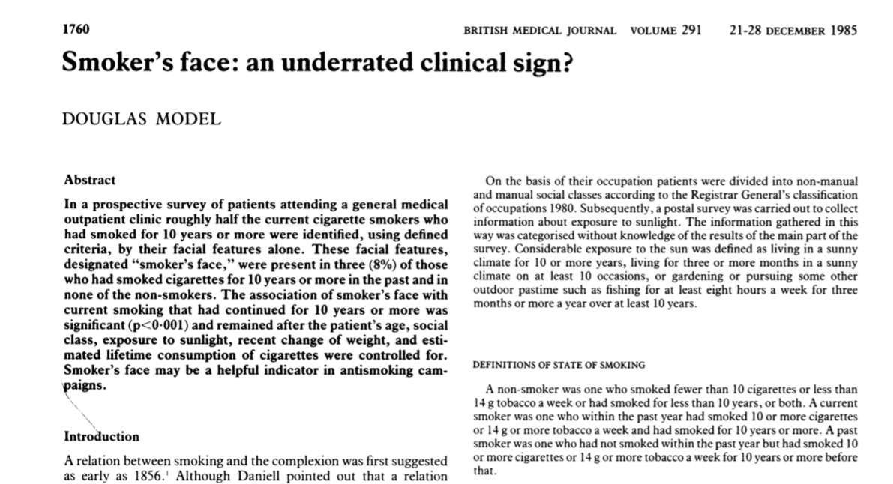
Smoker’s Face

Slide 44
Tip 6— Never round past your allotted time
Go see the other patients on your own
Circle back with resident/team later
Notes:
This came up over and over with the colleagues that I communicated with around the country. Our Morning Report is right after attending rounds, so this is a built in incentive NOT to go beyond allotted time. I also hate rounding longer than 2 or 2.5 hours and the residents know this—I tell them this in my expectations.

Slide 45
Tip 7— When possible, know the new patient before you come to rounds
Allows time to focus clinical questions and physical exam
Allows you to rehearse teaching points
Helps to hear it after reading it

Slide 46
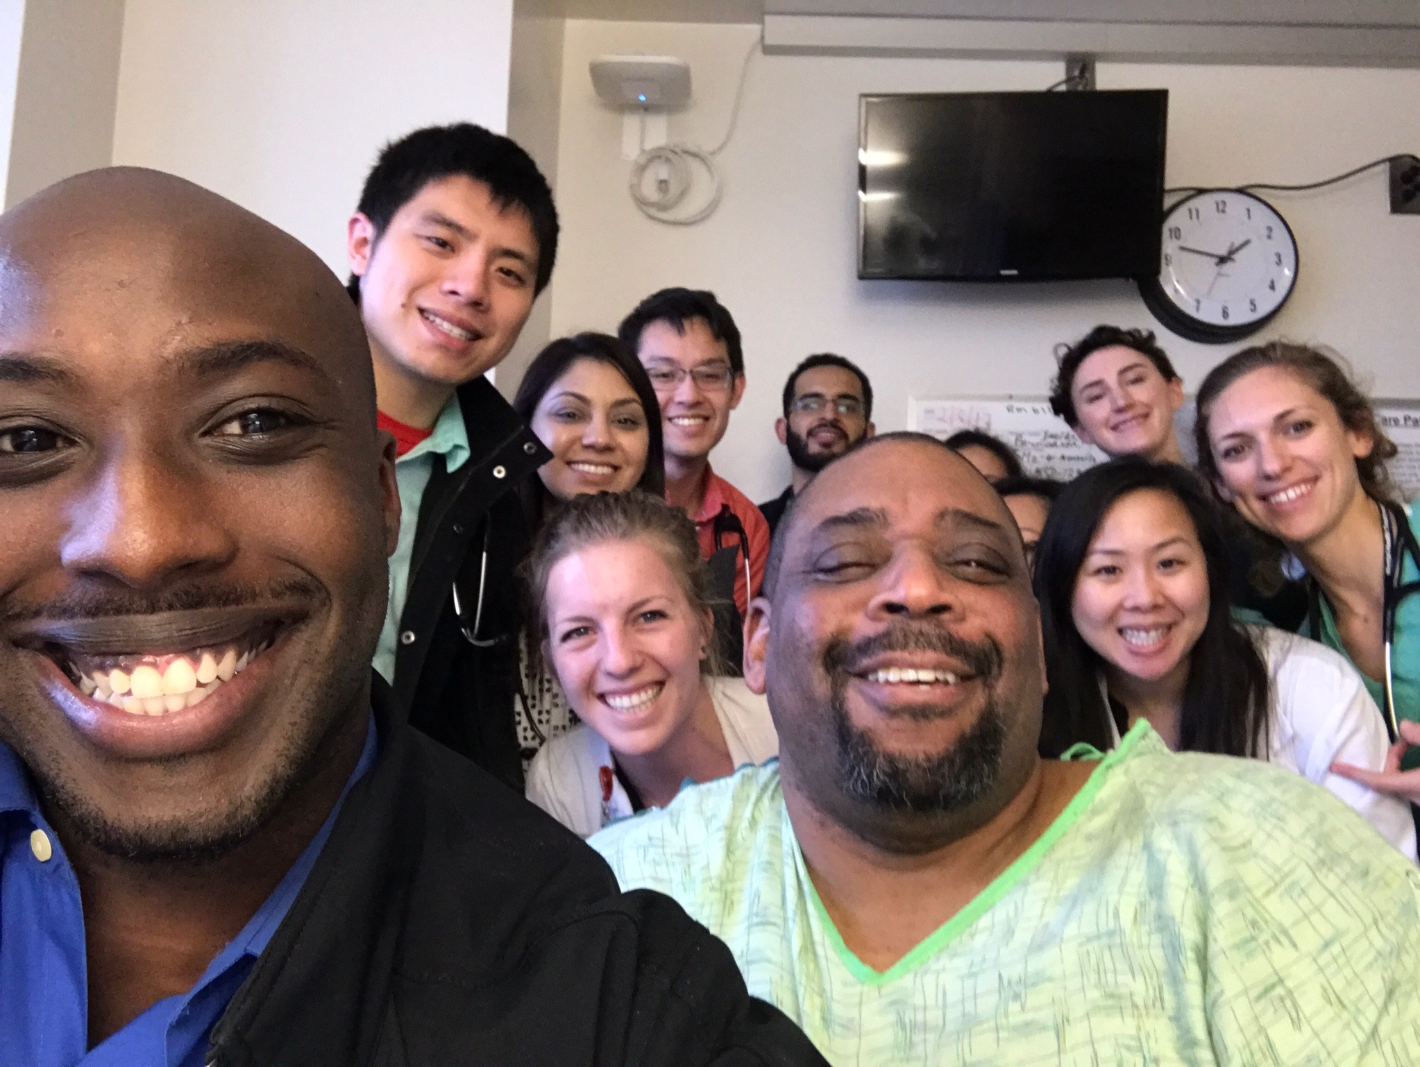
Tip 8— Round at the bedside whenever possible
Notes:
You guys are already doing lots of bedside rountds so I won’t belabor this tip. I do love this photo. I sent the students on our clerkship to meet this man who’d been admitted with new onset CHF because I wanted them to examine his forehead because he had something call a Zabiba or prayer callus from bowing down and praying to mecca 5 times each day. He Showed them that and then spent an hour teaching them about his Charcot Marie Tooth Disease and had such a great time that he insisted on taking a selfie with them at the end of the hour. To me, this image epitomizes the joy of being at the bedside.

Slide 47
Who should you round at the bedside on?
Sickest patients
Patients followed by students
Patients the resident wants more input on
Patients that benefit from seeing all of your faces
Patients that have something to teach

Slide 48
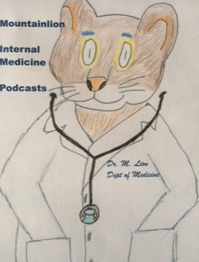
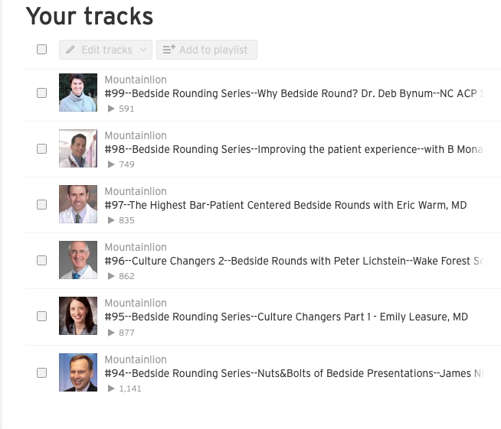
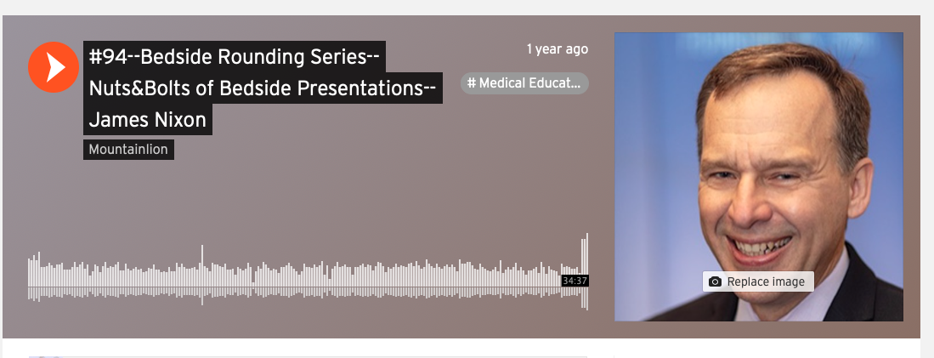
If you’re “iffy” about your bedside rounds

Slide 49
Tip 9— Have a computer at bedside when rounding
CRUCIAL FOR EFFICIENCY, if accomplishable
Great for physical exam immediate gratification

Slide 50
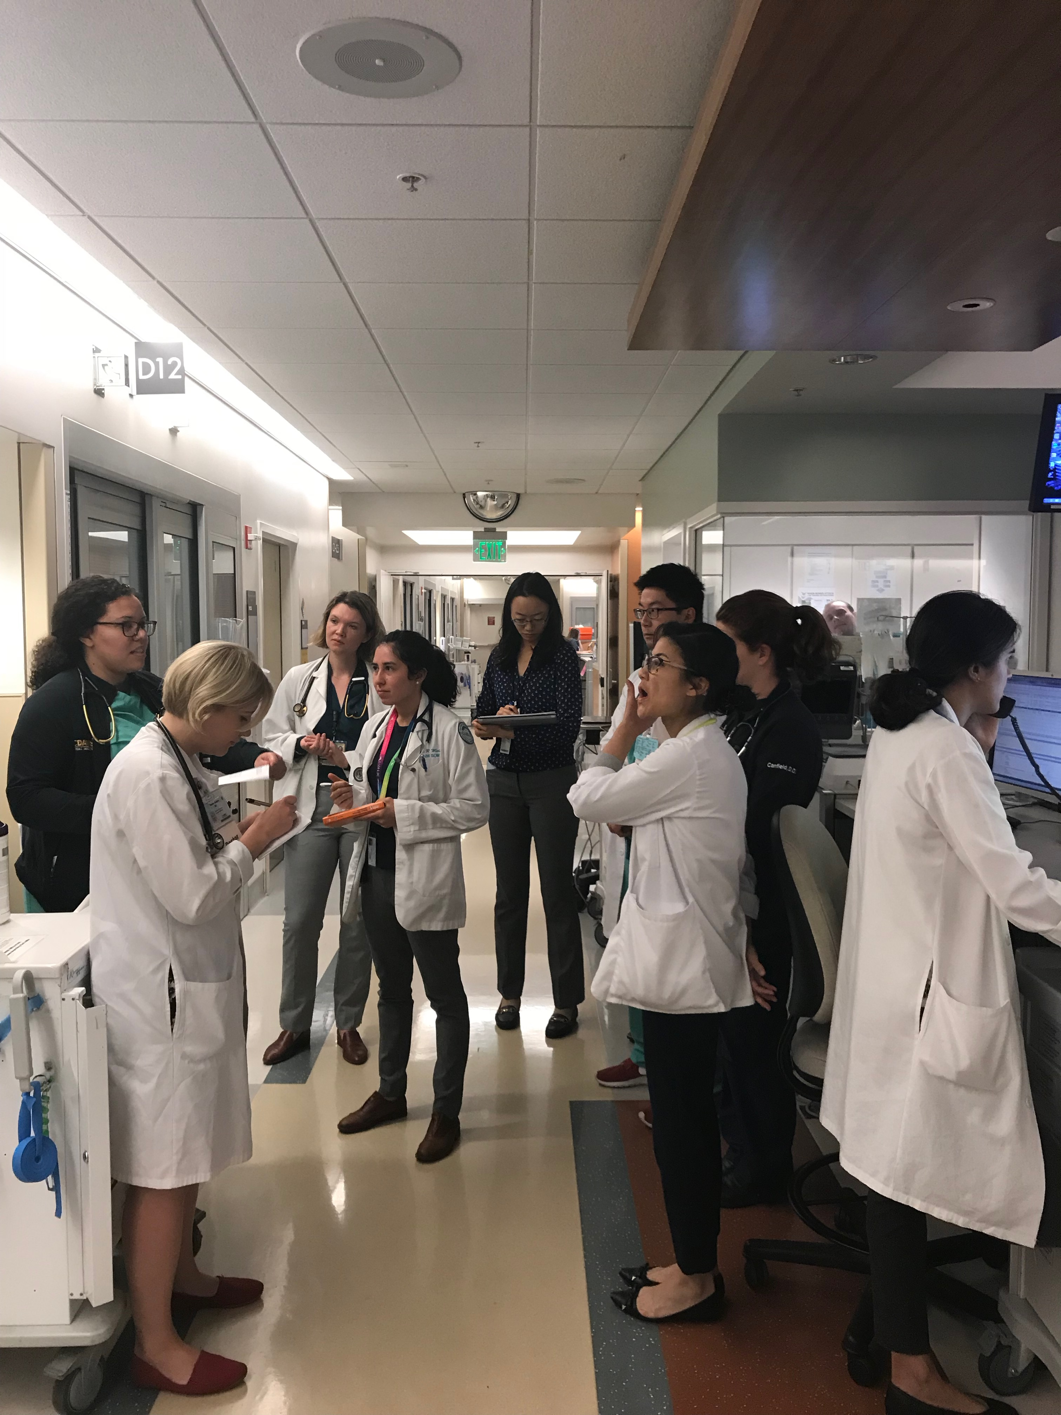
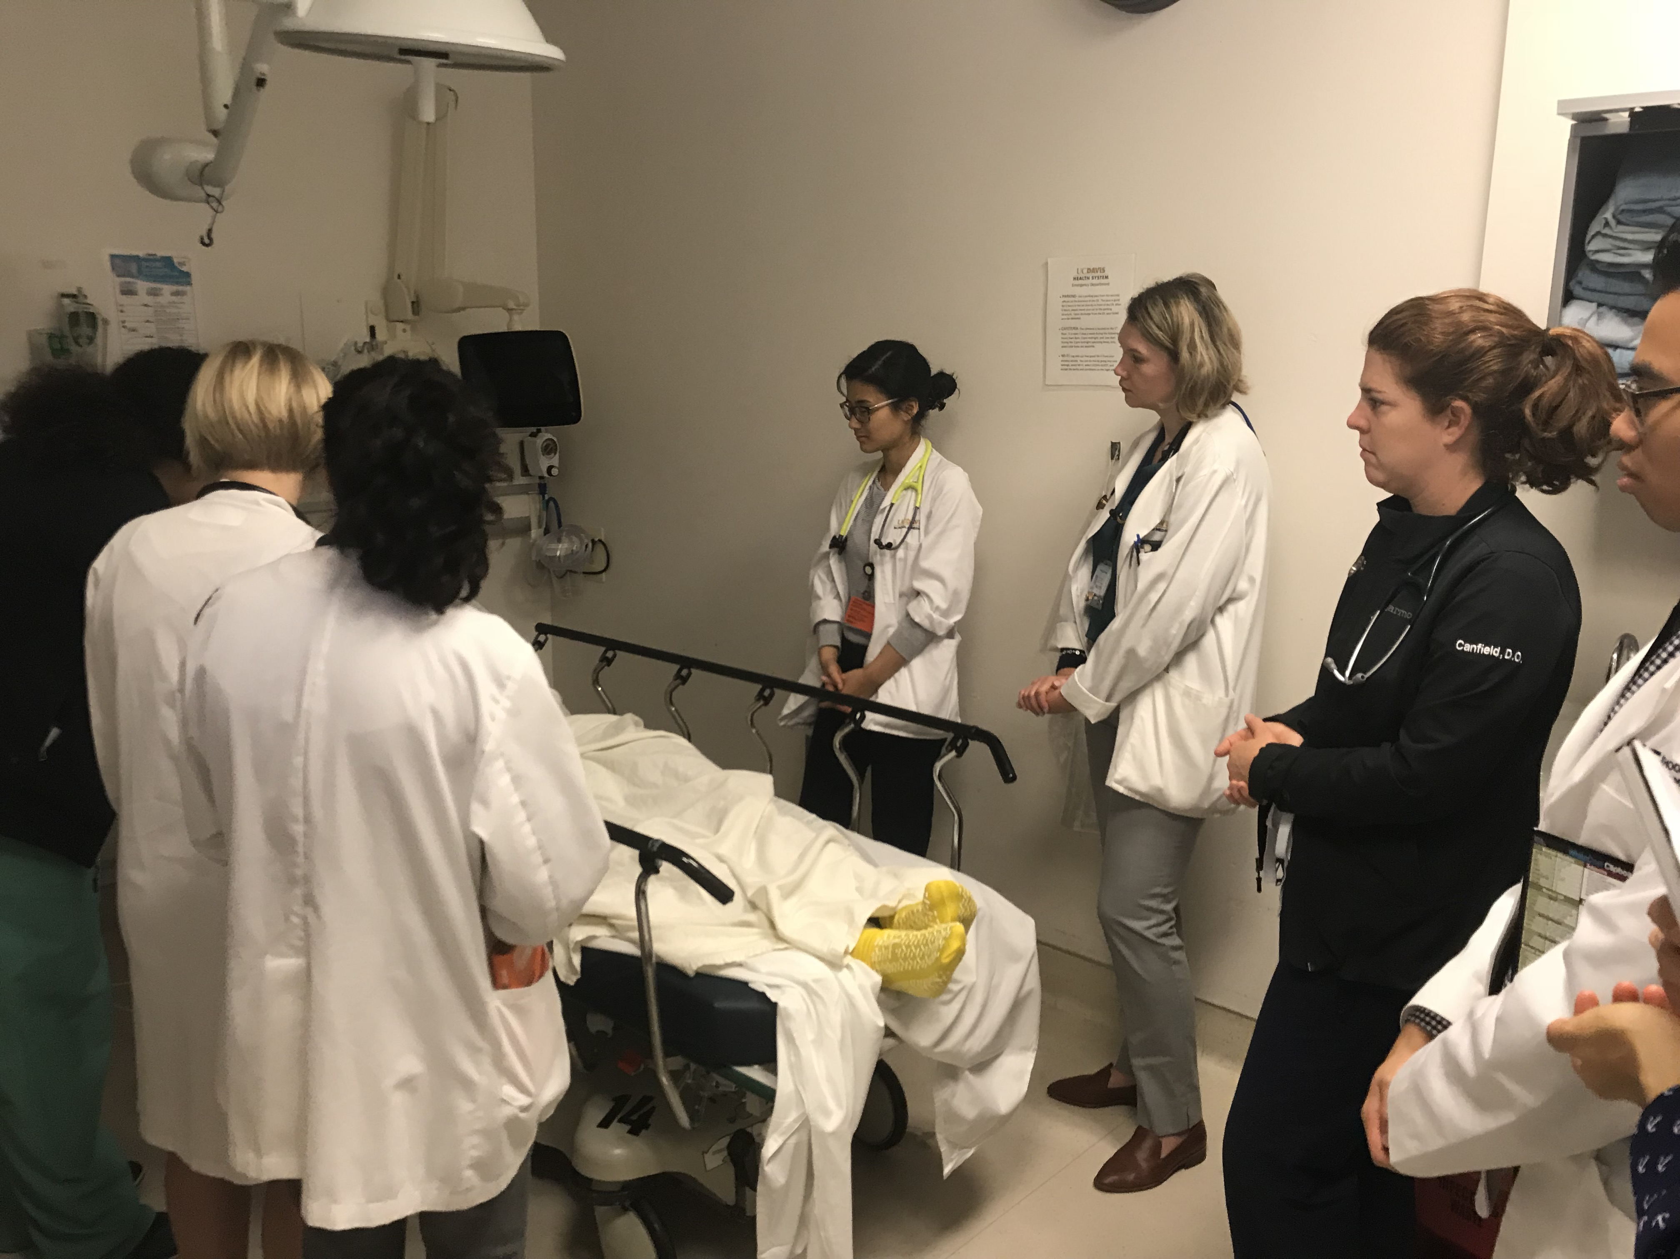
Tip 10— Let the resident run rounds sometimes

Slide 51
Tip 11— THE ART: Inspire learners’ drive to improve
Practice the art of subtle correction
Never (ever) humiliate a learner on rounds
Notes:
show them what they’re not finding and then show them how to get better at it
We made ourselves good…no one did that for us.
Example: Hearing murmurs….
Finding clubbing on a patient with IBD or cirrhosis

Slide 52
Tip 12— Utilize down time on rounds
….to get to know your team members….
Question of the day
Notes:
What animal would you be?
What’s the craziest thing you ever did that no one on this team would believe?
If you weren’t a doctor, what job would you like to be doing?
Studies have shown that many medical students want their attendings to, at least, know their names. Spend time getting to know your team members.

Slide 53
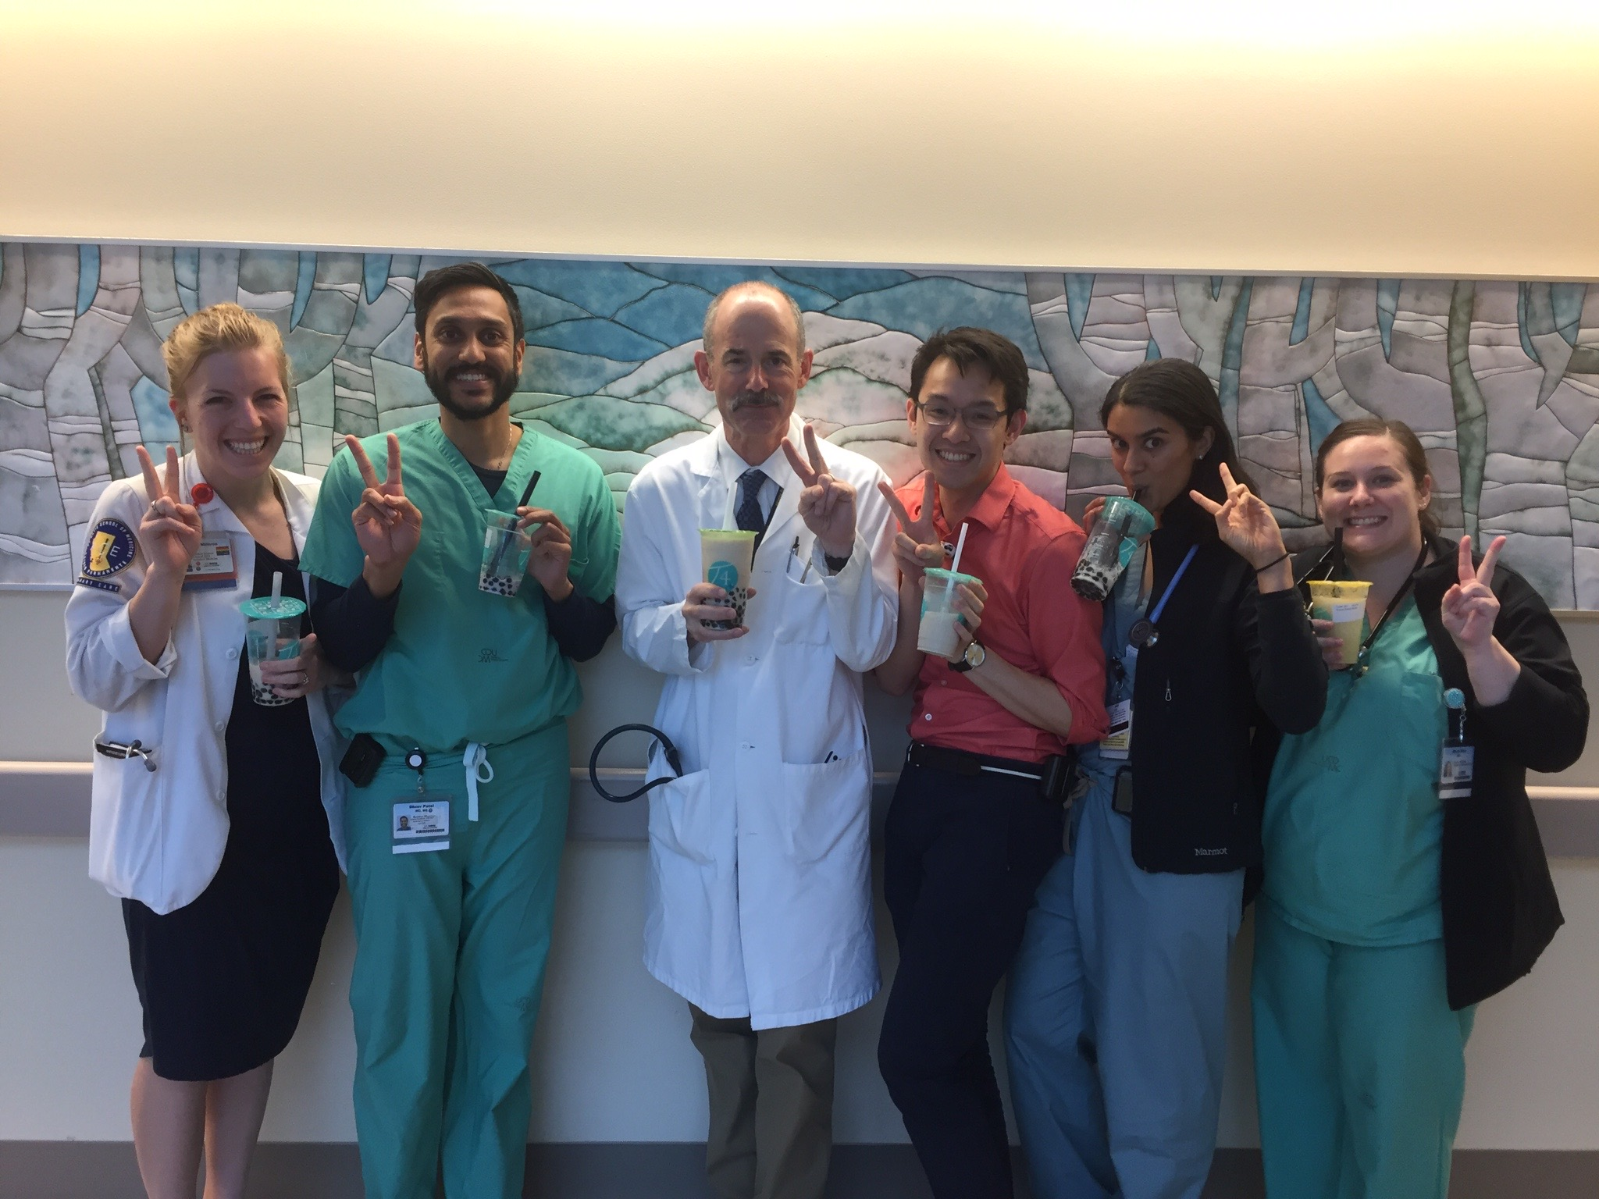

Slide 54
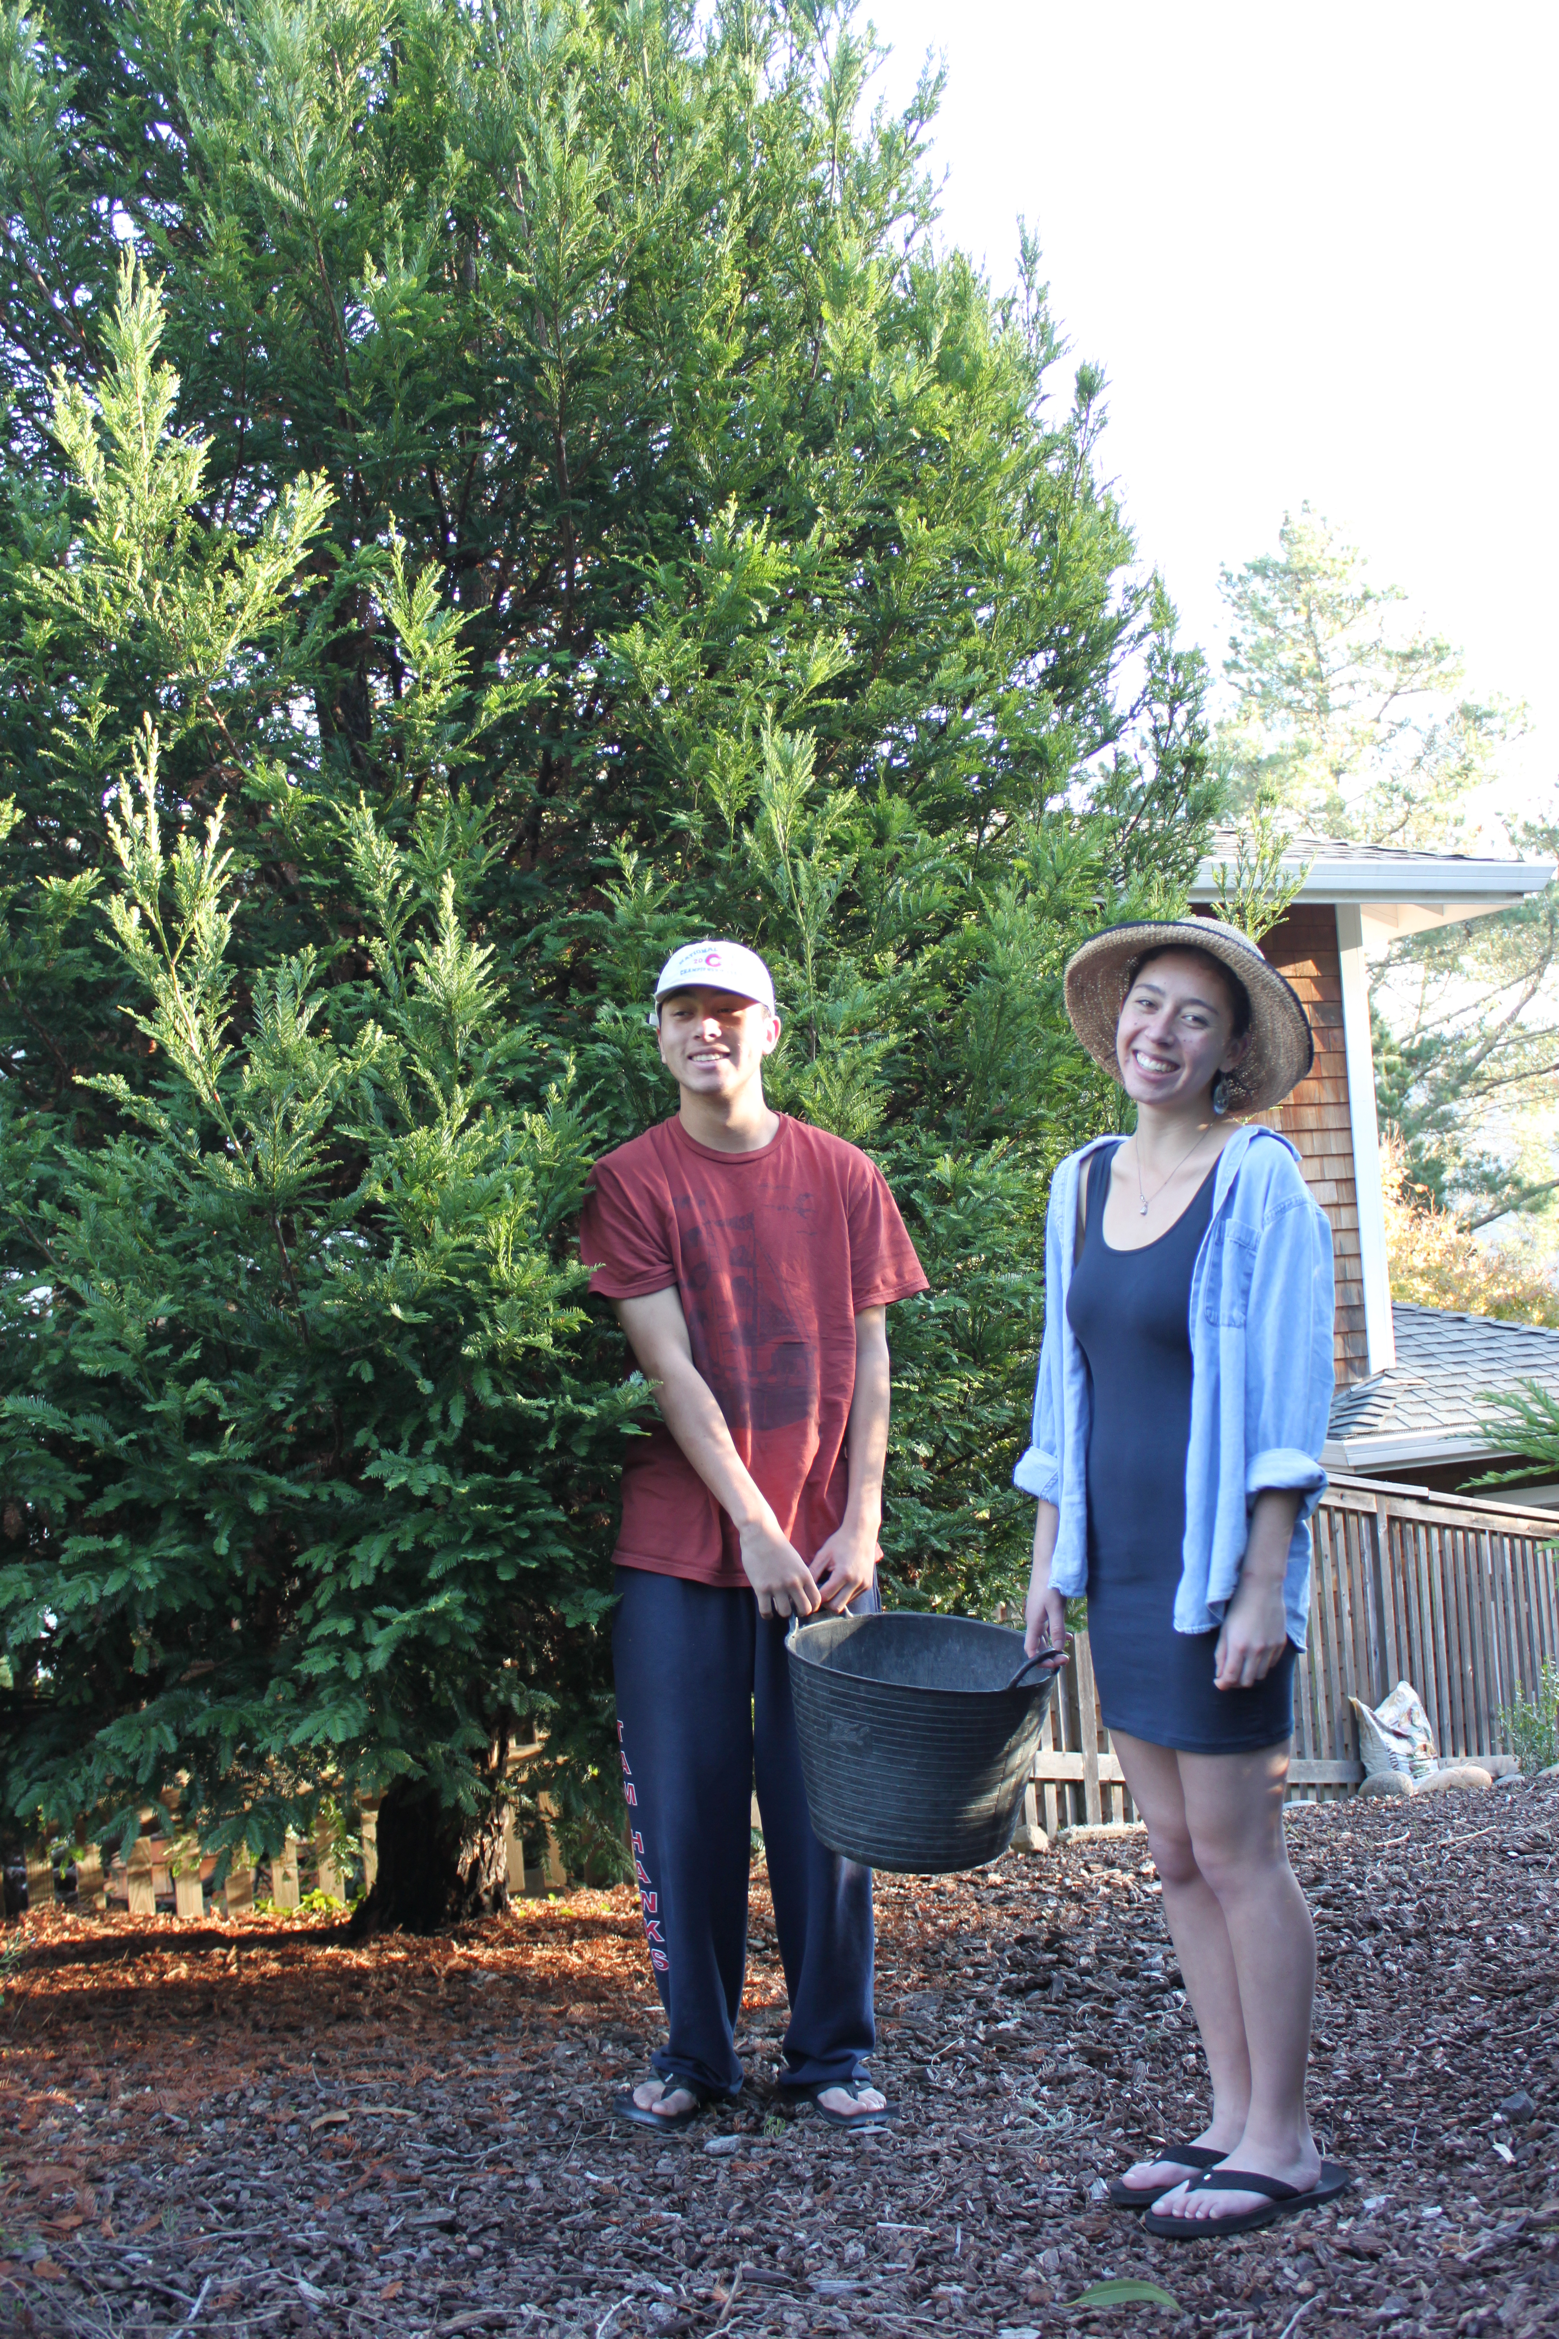
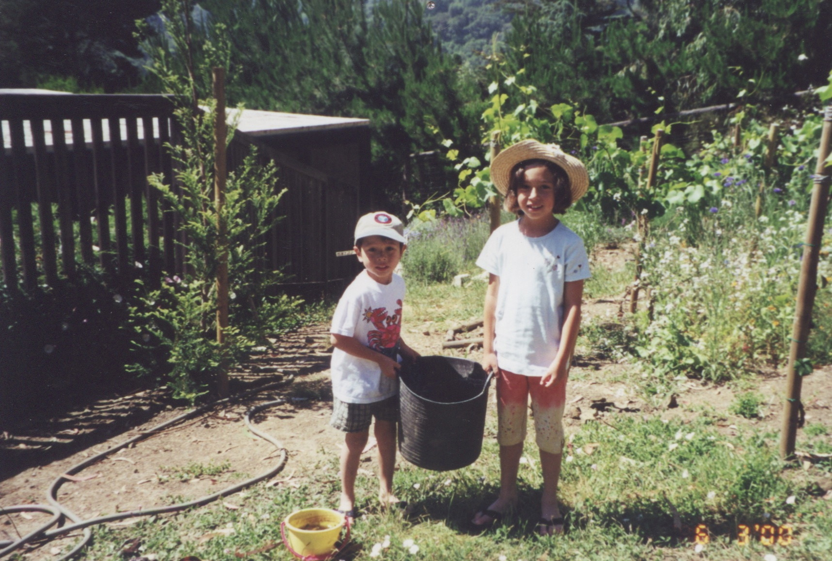
Tip 13— Grow trees don’t kill trees—Except for your night float
Send articles via email
Notes:
Send clinical challenges
Clinical question of the day
Clinical image challenge
Medical trivia
Assign a team member to answer it on next rounds

Slide 55
Tip 14— Practice “Slow Medicine” Later
Teaching students about how to break bad news
REALLY hearing the murmur from patient this morning
(Carefully) examining a patient with cirrhosis
Diving into a patient’s chest pain HPI

Slide 56
Tip 15— Consider teaching in-depth topics in a different setting

Slide 57
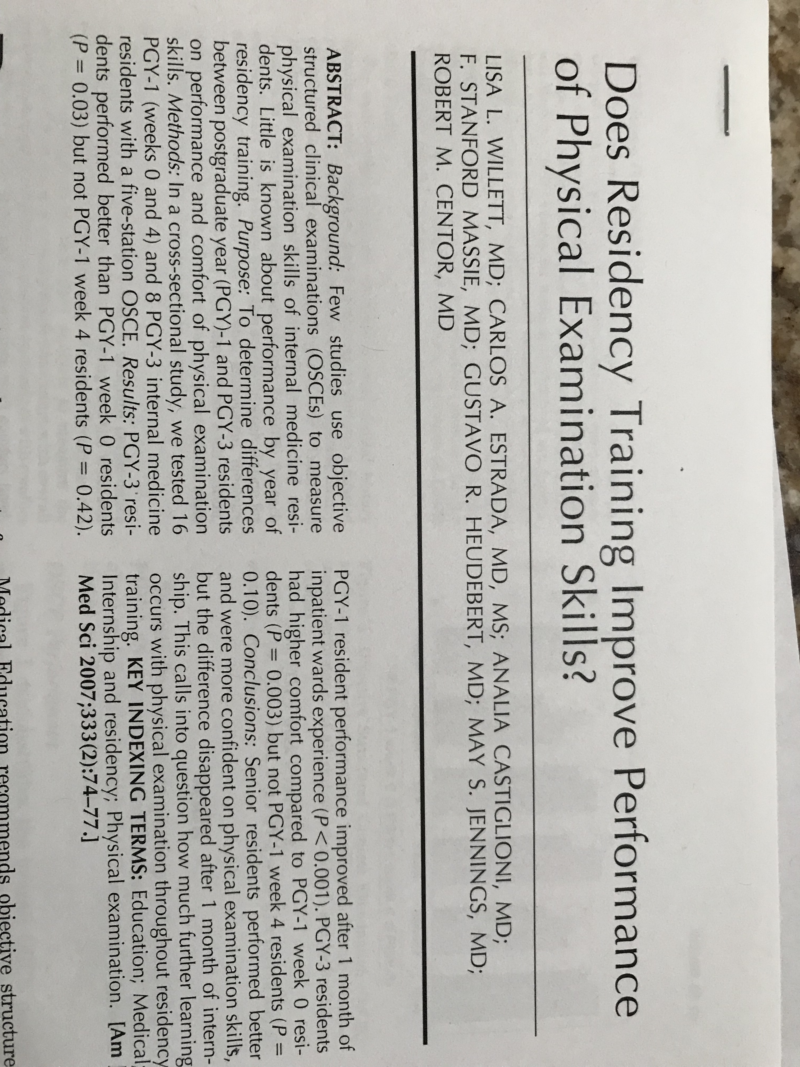

Slide 58
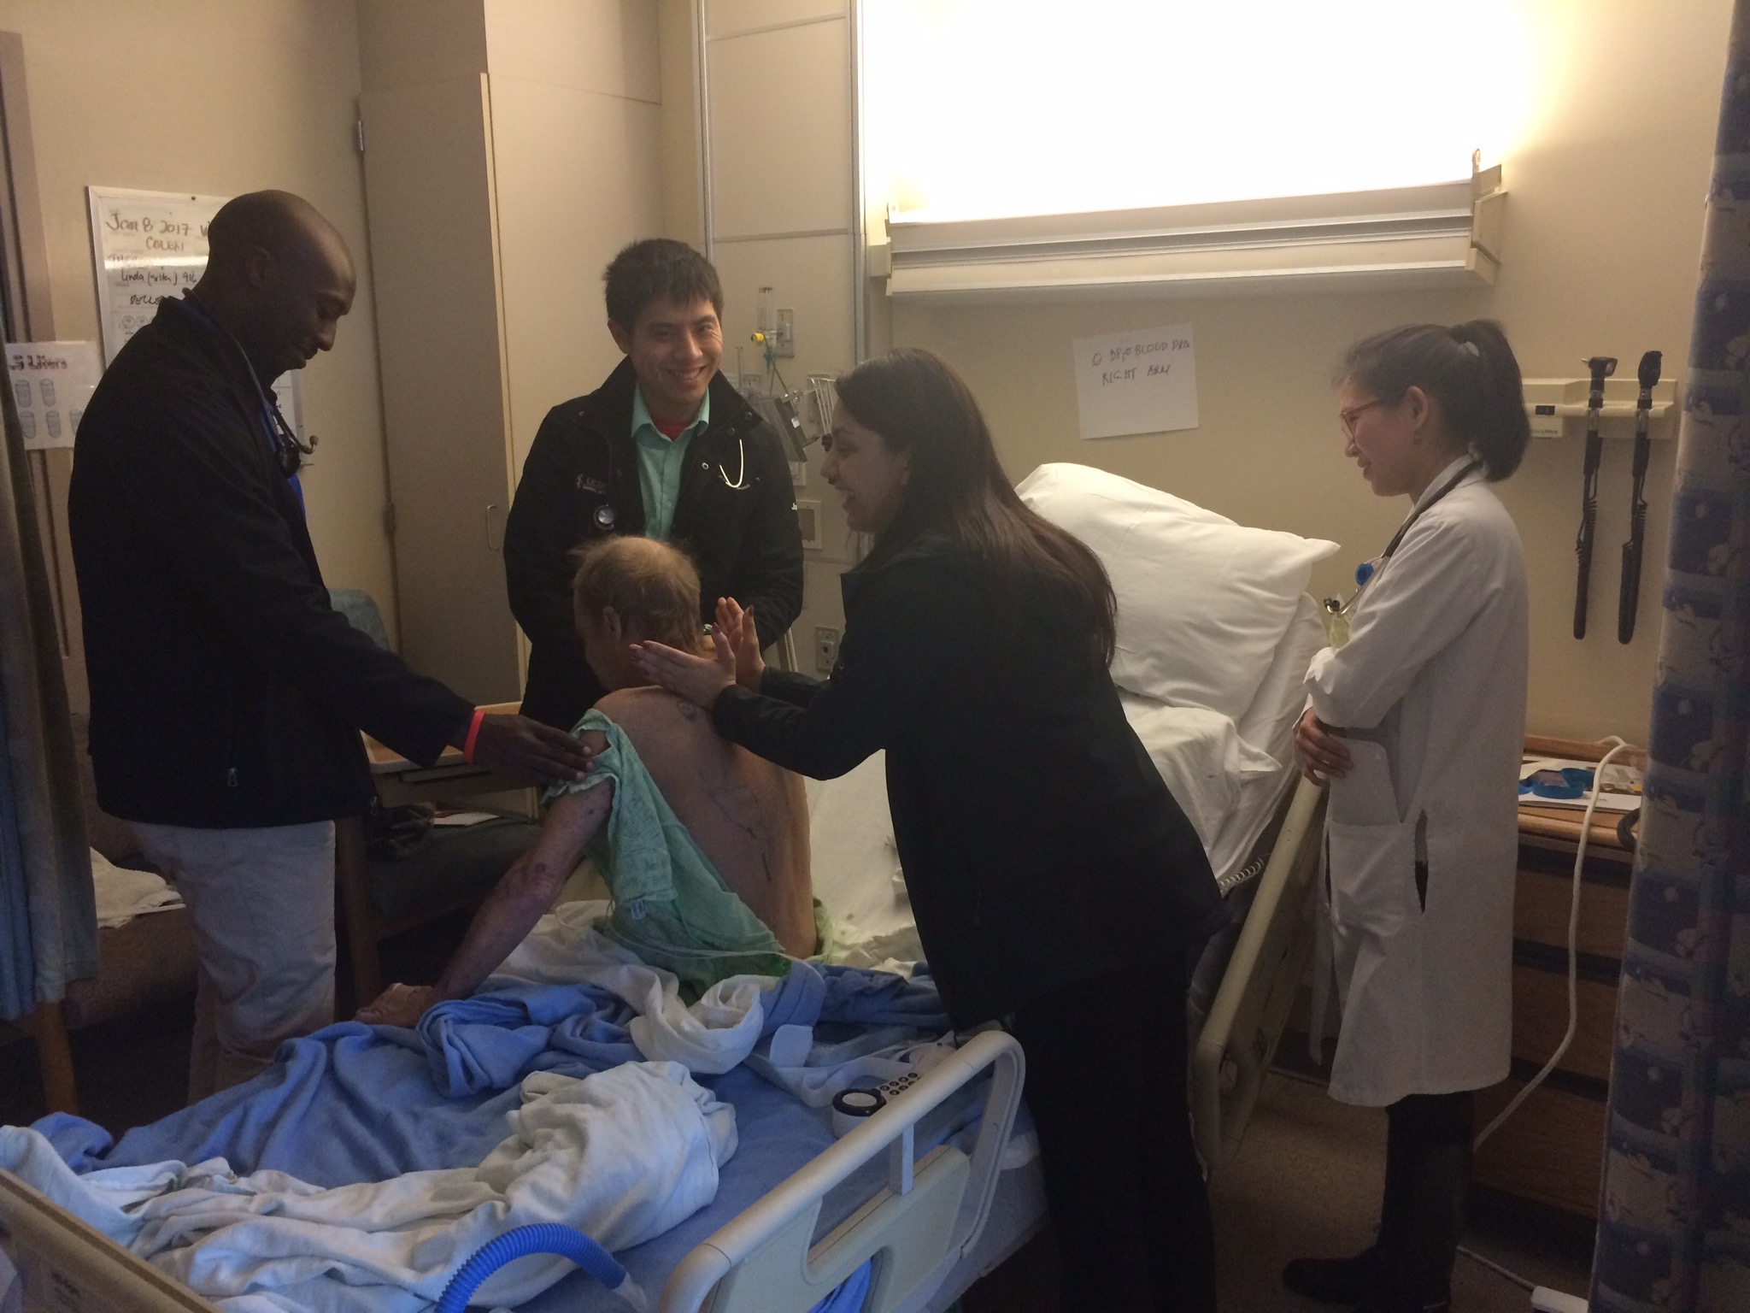
Observe the observer and then observe the observer observing….

Slide 59
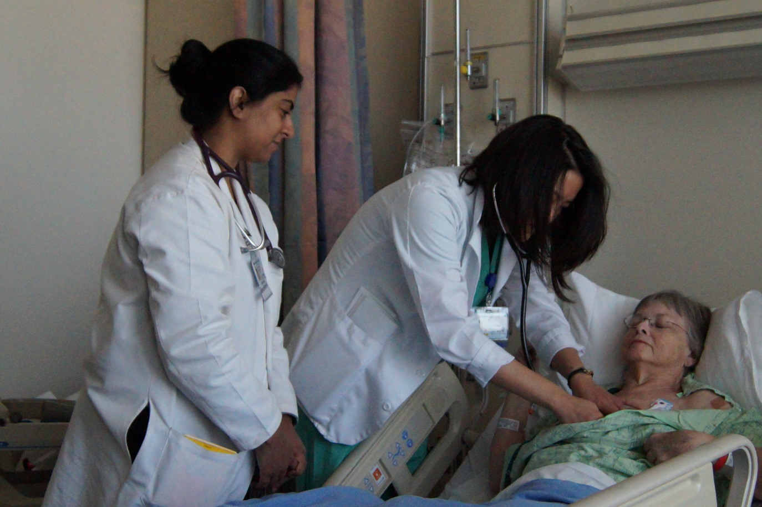

Slide 60
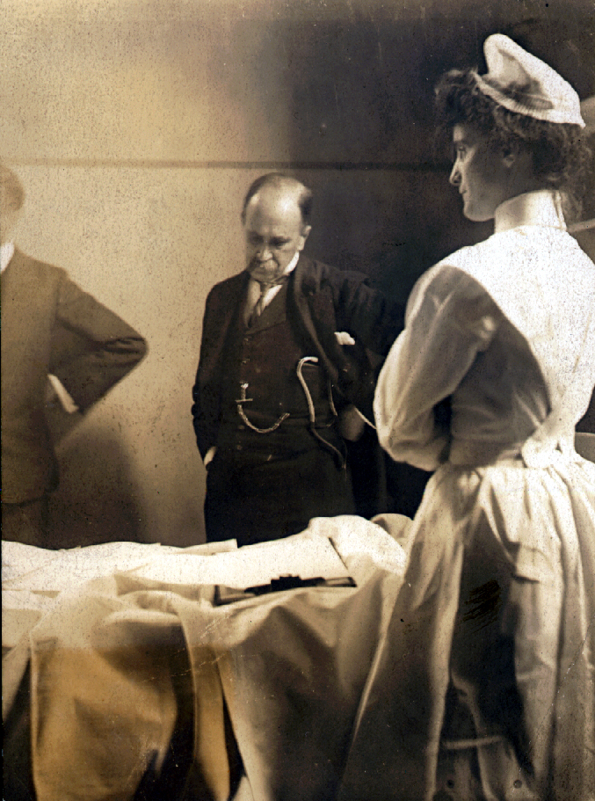

Slide 61
Summary
Attending rounds in the 21st Century are remarkably complex
Recognize the complexity of these rounds
Reflect upon what you want them to be
Focus on improving yourself and your attending rounds will lead to educational and efficient rounds

Slide 62
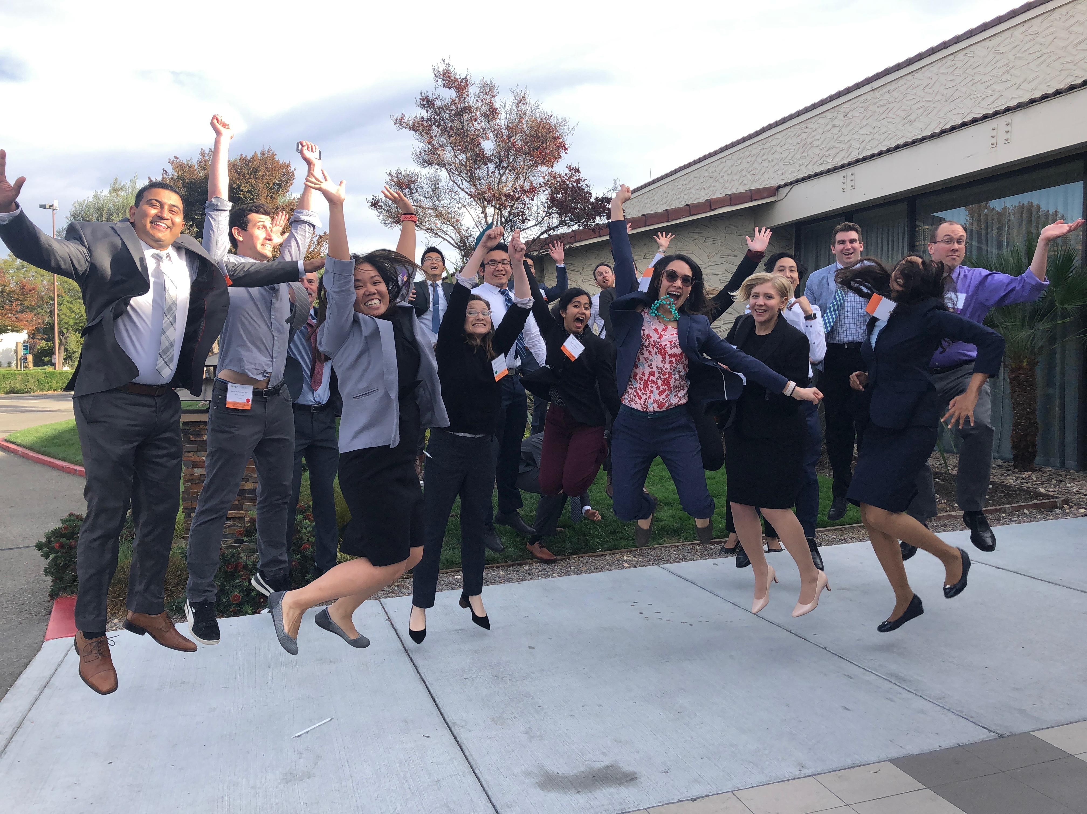
Thanks for your attention!

